Slide 1
Intracellular recordings in the ELL of a weakly electric fish
Kathrin Root, Alexander Wendt, Patrick Weygoldt

Slide 2
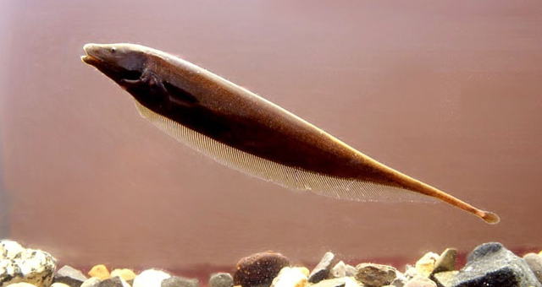
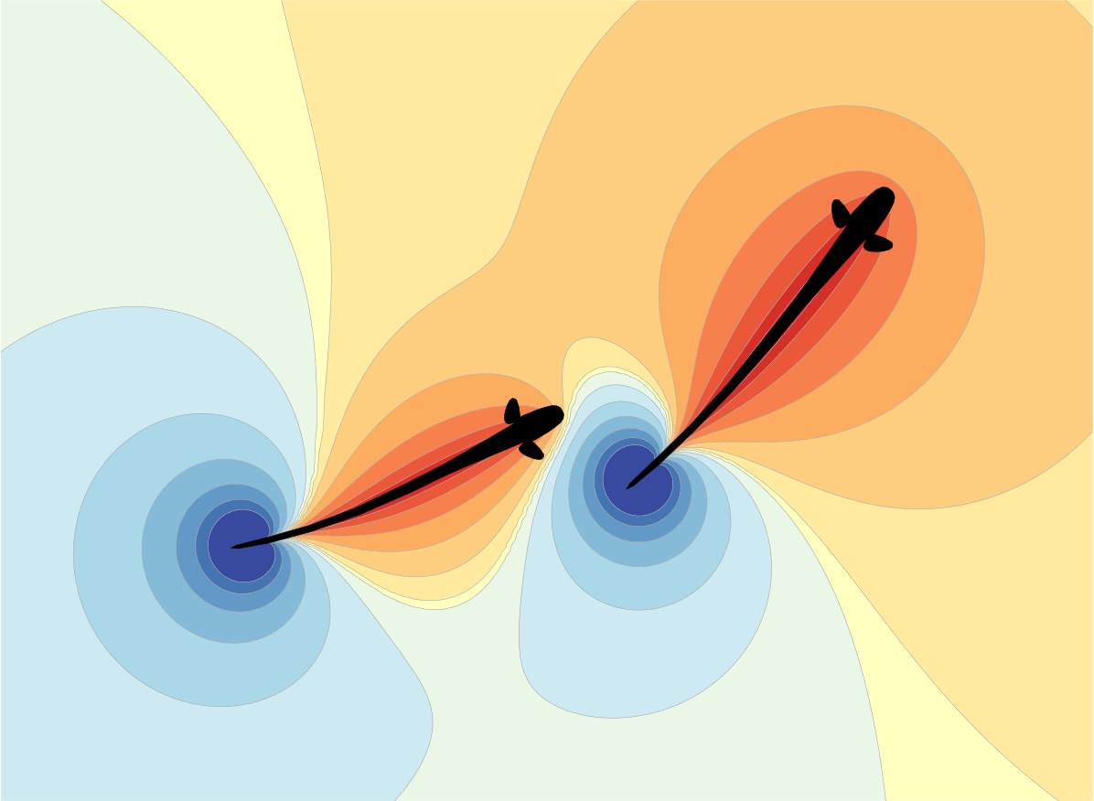
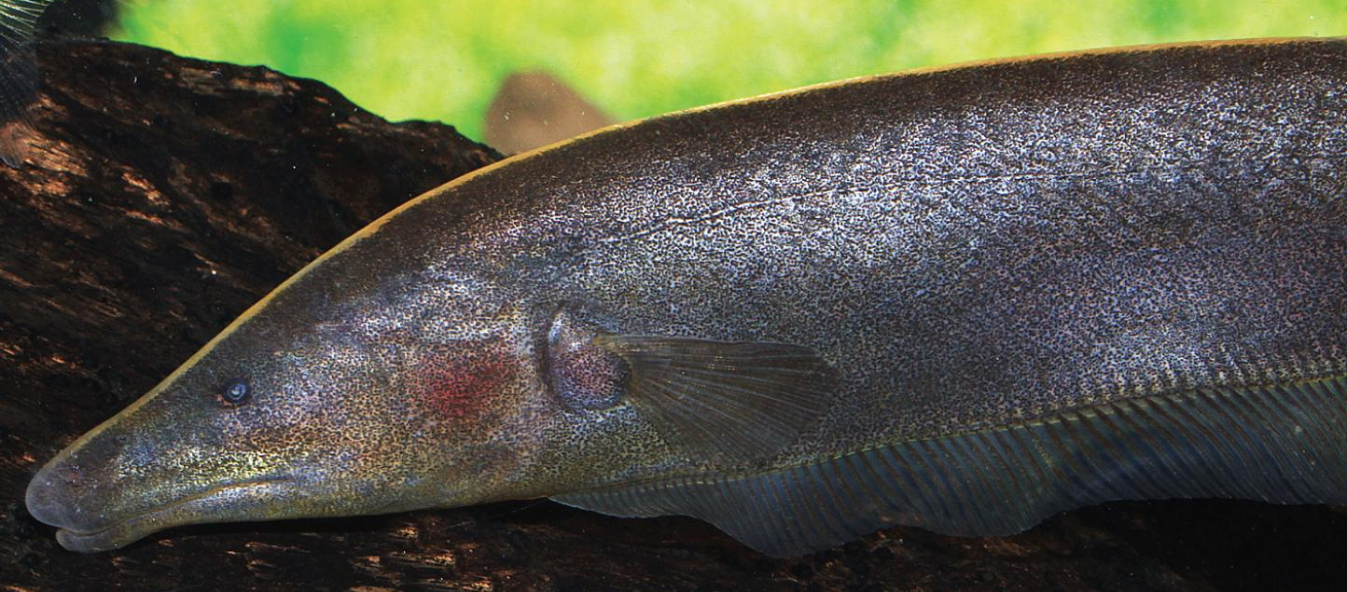
Introduction - Apteronotus leptorhynchus
… Electrolocate & communicate via a self generated electric field!
https://www.fishbase.se/images/species/Aplep_u7.jpg
https://www.aqualog.de/wp-content/uploads/2016/08/brown_ghost.jpg
https://bendalab.github.io/pubs/Benda2020-ElectrosensoryWorlds.pdf
Notes:
Our block course was about the Apternotus Leptorhynchus
The natural Habitat are the riverbanks of south America

Slide 3
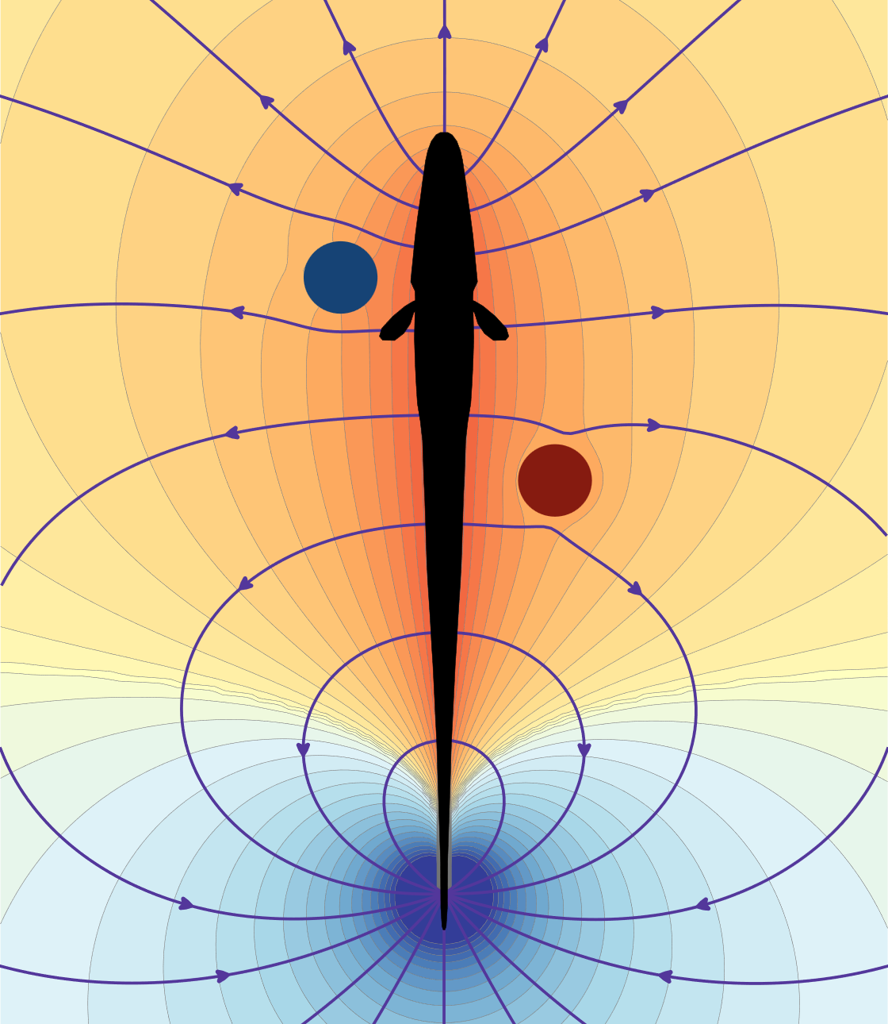
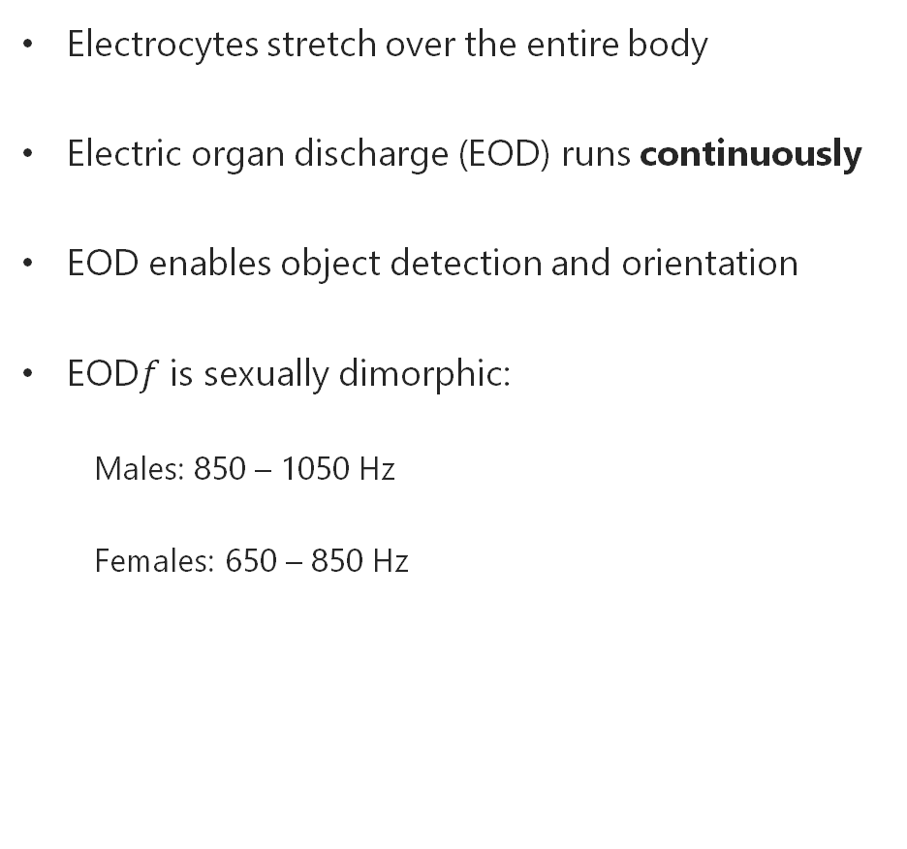
Introduction – Electric organ
Electrocytes stretch over the entire body
Electric organ discharge (EOD) runs continuously
EOD enables object detection and orientation
EOD$f$ is sexually dimorphic:
Males: 850 – 1050 Hz
Females: 650 – 850 Hz
https://bendalab.github.io/pubs/Benda2020-ElectrosensoryWorlds.pdf
Notes:
Is a constantly changing dipole field

Slide 4
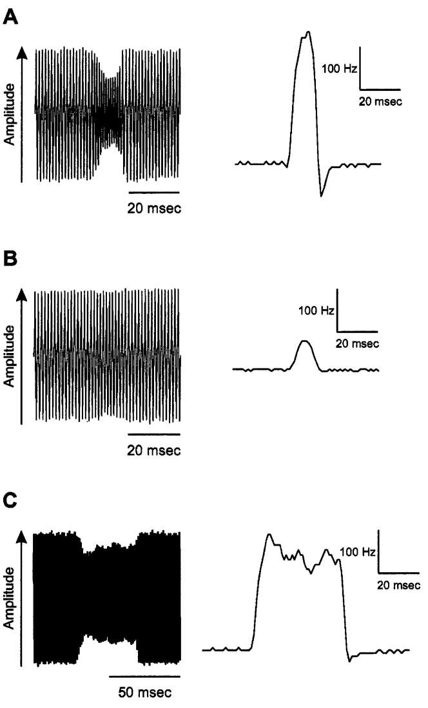
Introduction - Electrocommunication
A: Type 1 chirp, territorial signal
B: Type 2 chirp, aggressive threat signal
C: Type 3 chirp, mating signal
G. Engler, G.K.H. Zupanc (2001)
Notes:
Chirps are communications signals with an increase in frequency
We are using Chirp in picture B

Slide 5
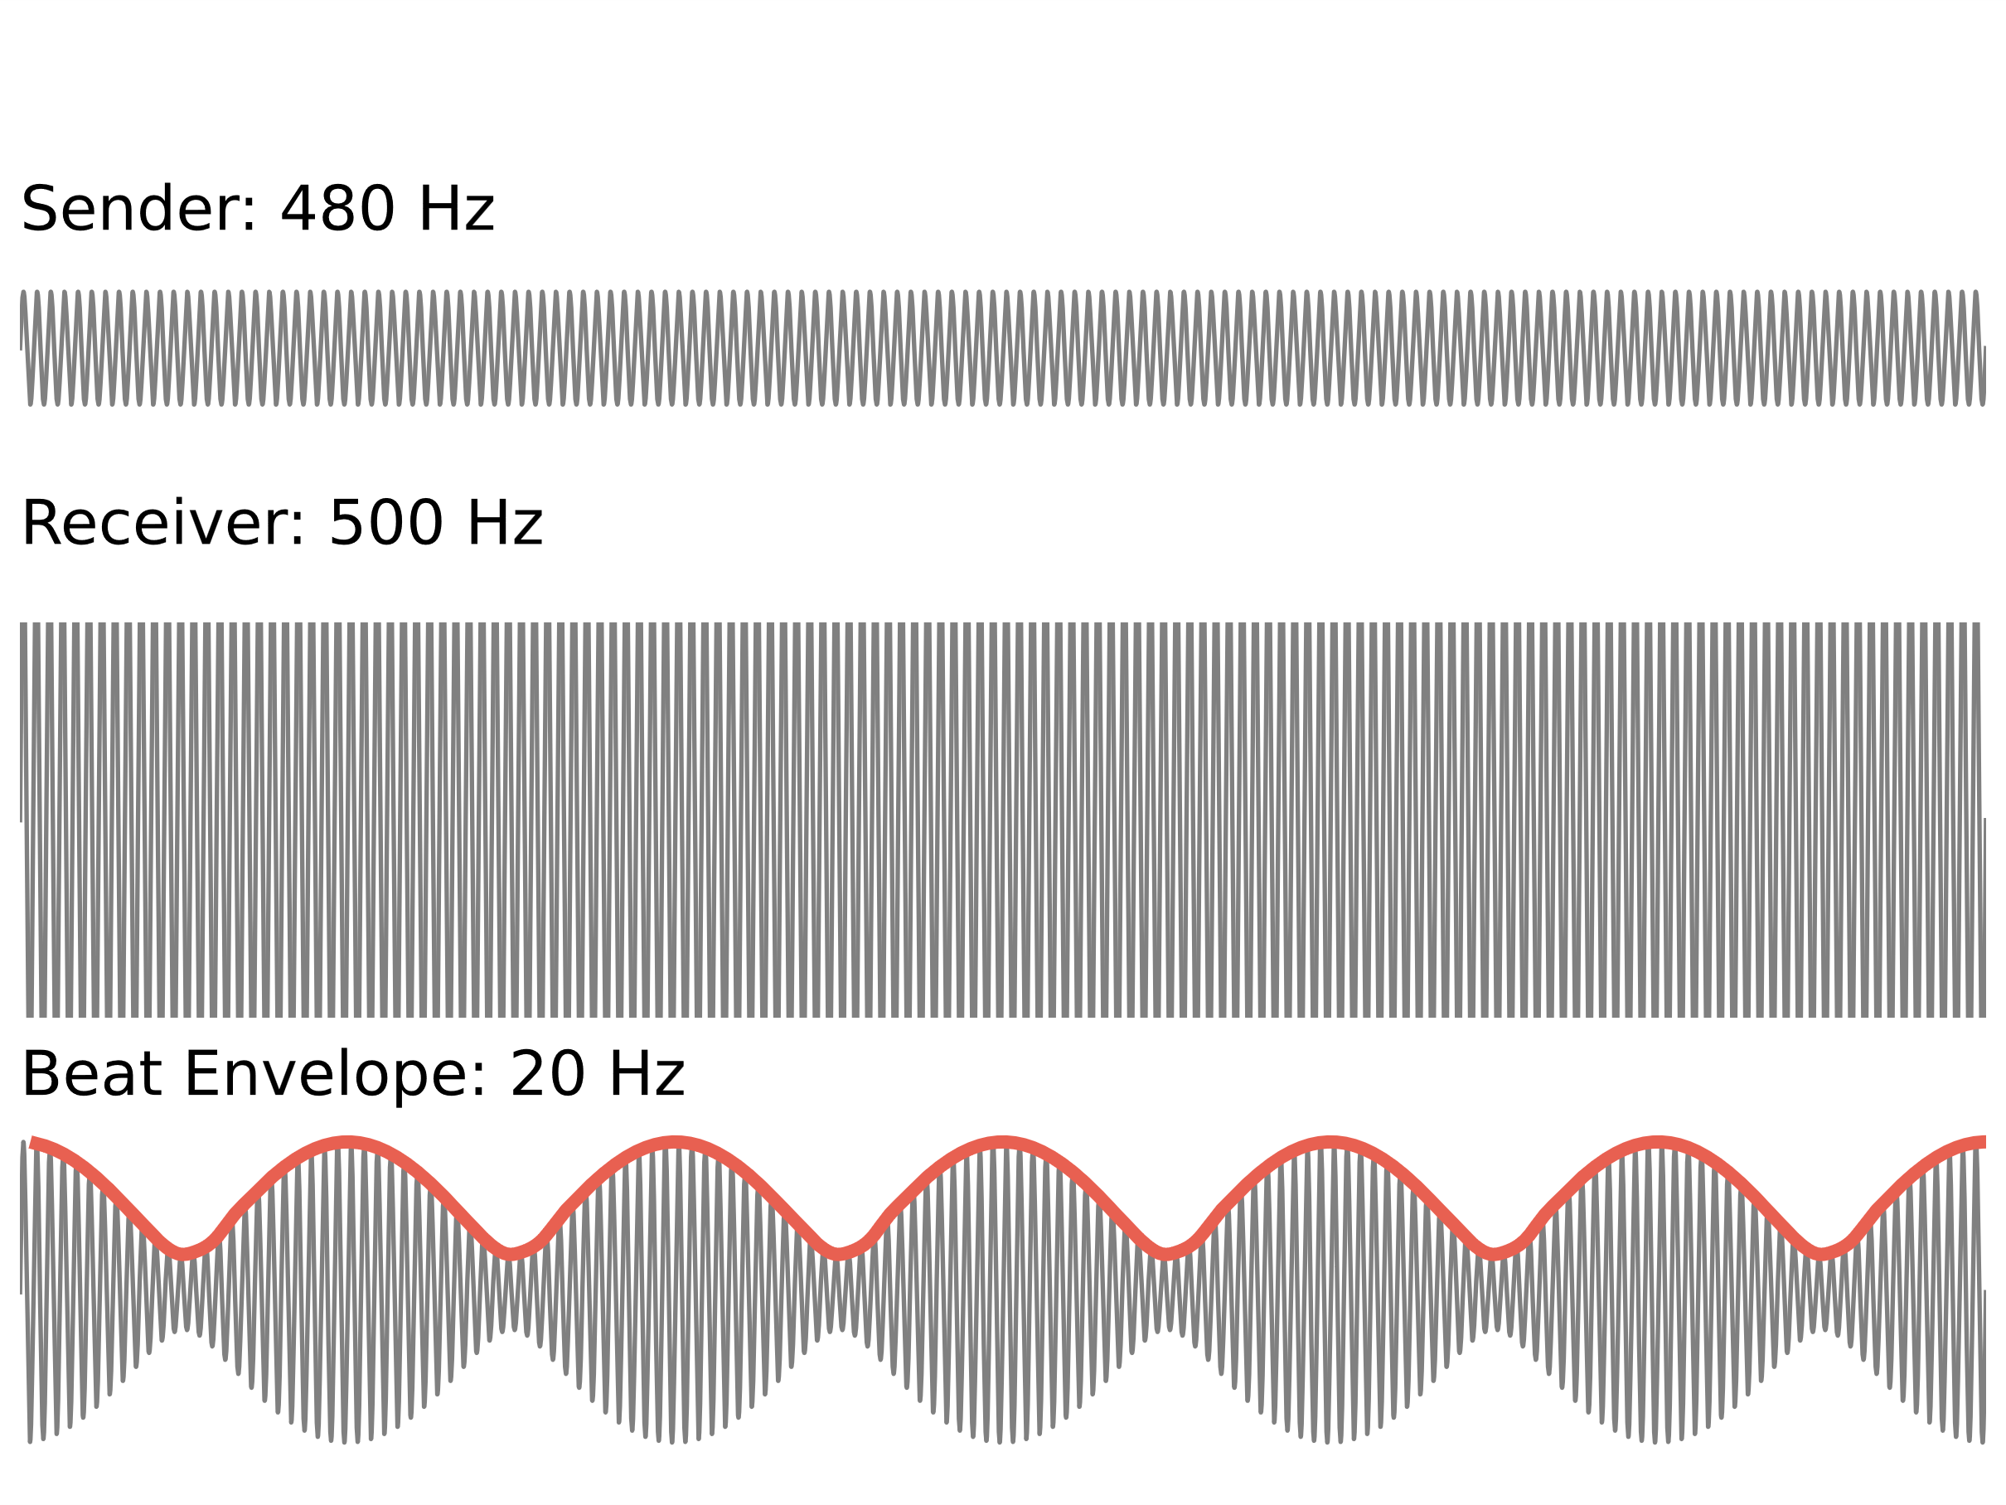
Introduction - Electrocommunication
https://bendalab.github.io/pubs/Benda2020-ElectrosensoryWorlds.pdf
Notes:
In the natural habitat when two fish are near each other, their electric field collides
Here you can see the EOD of the sender at 480 Hz and the EOD of the receiver fish at 500 Hz
What happens when the two eods collide is, that the two eods merge and a new eod, called beat, emerges
In this example the result of those two eods would be 20 Hz

Slide 6
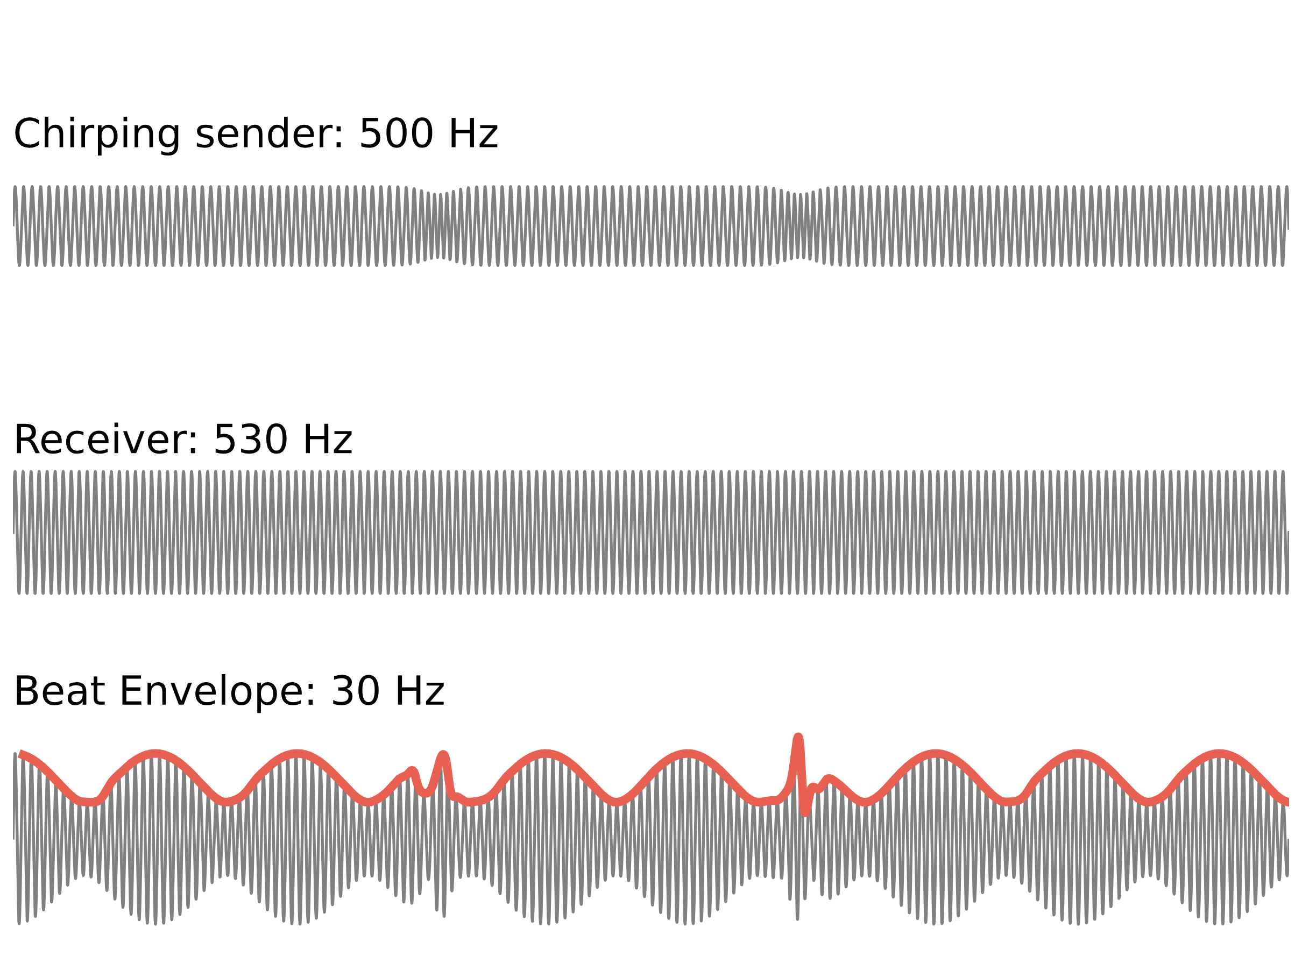
Introduction - Electrocommunication
Notes:
And now what does the signal look like when the fish chirps?
This you can see in the fist plot, the chirp has a smaller amplitude
The result of the sender and the receiver EOD is the same as before but with chirps

Slide 7
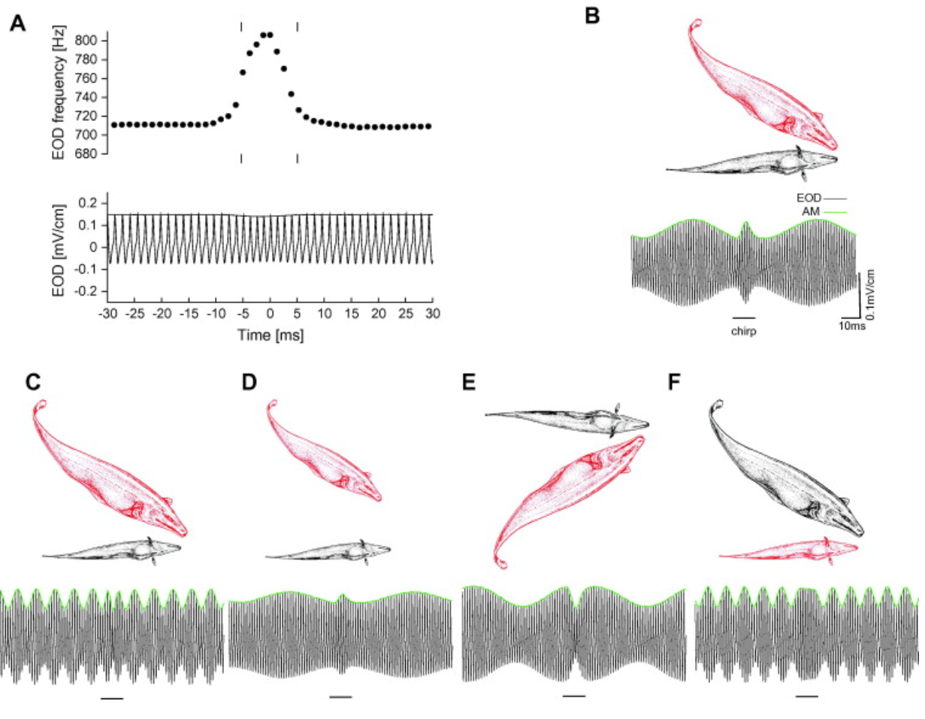
Introduction - Electrocommunication
Henriette Walz, 2013
Notes:
Here is depicted how the beat changes with the changing position of the two fish
Unterschiedliche situationen
Interferenzmuster können sich unterschiedlich ausprägen

Slide 8
Introduction – P-units
P-units
Spontaneous activity
React to own electric field
Project into the electrosensory lateral line lobe (ELL)
https://www.aqualog.de/wp-content/uploads/2016/08/brown_ghost.jpg

Slide 9
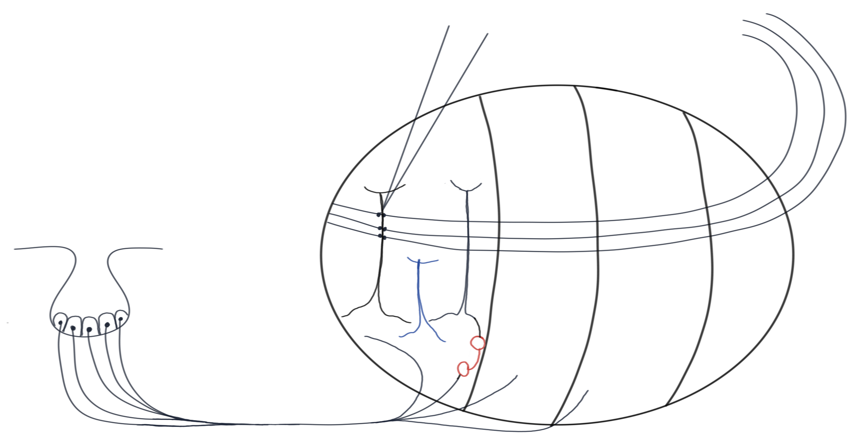
Introduction – ELL pyramidal cells
Electrode
Inhib. feedback
CLS
CMS
Superficial pyramidal cell
LS
MS
Deep pyramidal cell
Interneuron
P-Unit
Notes:
The fish has special pores stretched over the whole body
Pores are filled with electroreceptors
Each receptor innervates the p-unit
P- unit innervates pyramidal cells in the three segments of the ELL -> LS, CLS, CMS aber nicht ins MS
There are 2 types of pyramidal cells:
Superficial cells
Deep cells
If the pyramidal cell is innervated by the p-unit with an interneuron in between, the pyramidal cell will be inhibitory because
the interneuron emits inhibitory neurotransmitters (GABA) -> those cells are called OFF cells
If the p-unit is directly connected to the pyramidal cells the pyramidal cells are excitatory (glutamate) -> they are called ON cells
The superficial cells are innervated by inhibitory feedback cells, this is the reason why the firing rate of superficials decreases overtime, because the feedback cells inhibit the response
The deeps are not innervated by feedback cells and therefore have a higher firing rate that doesn’t decrease over time

Slide 10
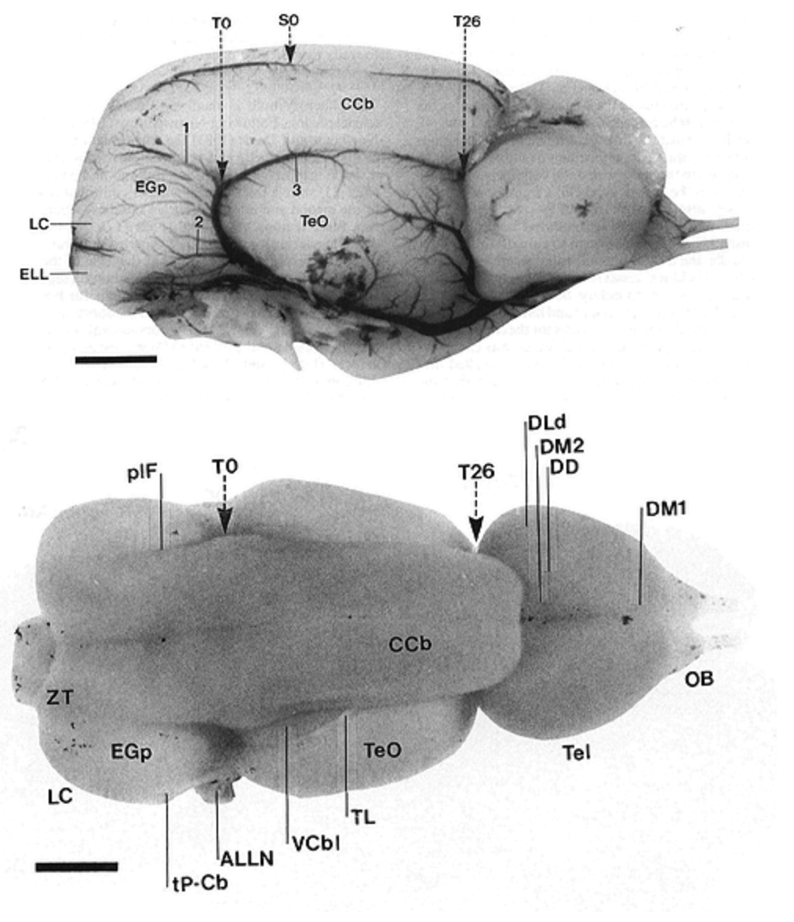
Introduction – Brain regions
http://nelson.beckman.illinois.edu/atlas.html
Notes:
Grobe übersicht: rostral, caudal, mittelhirn, hinterhirn

Slide 11
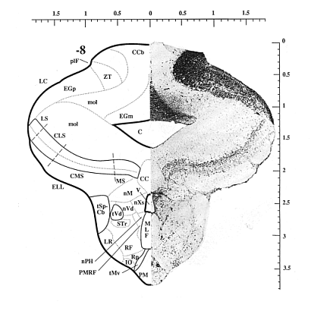

Introduction – Brain regions
http://nelson.beckman.illinois.edu/atlas.html
http://nelson.beckman.illinois.edu/atlas.html
Notes:
Recording at 500µm
We tried to record in pyramidal cells but failed to record the cells without losing them quickly
We failed for the 4 first fish and in the last fish we finally found one pyramidal cell and could hold it for over an hour
So the following results are all computed from this one good cell we found

Slide 12
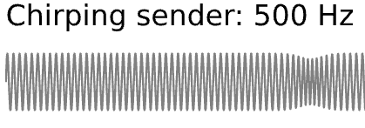
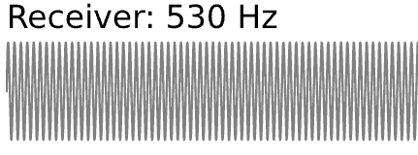

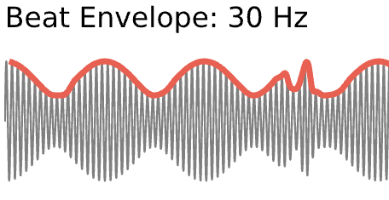
Methods – Recording setup
DAQ
Relacs
Stimulus isolator
Local EOD
Membrane potential
Multiplier addition
Global EOD
Stimulus electrode

Slide 13
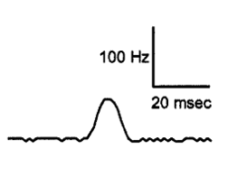
Research aim
Literature stimuli are confined to small frequency ranges
Natural stimulus regime is much more diverse
Does the cell answer to chirps?
How are chirps encoded for diverse beats?
G. Engler, G.K.H. Zupanc (2001)

Slide 14
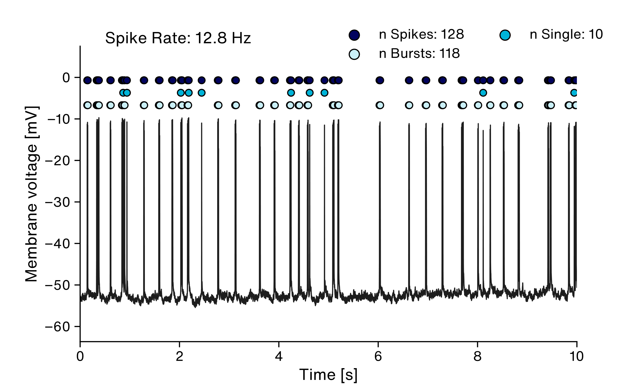
Results - Baseline
Notes:
We got a cell Yuhu!
X = time in Seconds
Y= Membran Voltage in mili Volt
Basline Plot:
* Spike Rate is Low compared to p Units
* in This time Window are 128 Spikes
First thing we did is to check if the Cell reacting to our Chirp Stimulus
and to calculate the this, we want to show a small sketch

Slide 15



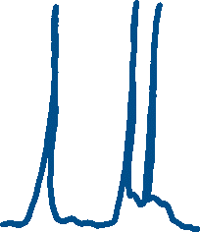


Chirp-triggered average calculation

Slide 16
Chirp-triggered average calculation
Notes:
So this is ALL data pooled
Centered all trials

Slide 17
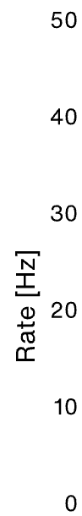
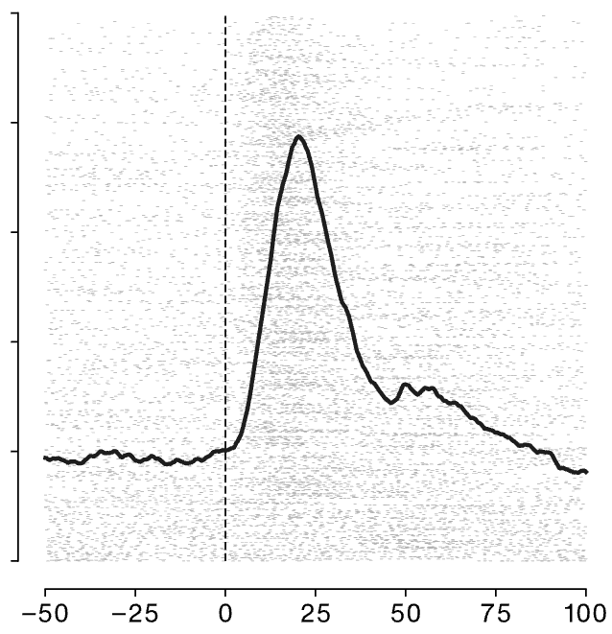
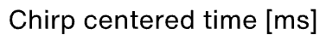
Results – Chirp response
Notes:
Y: Firing rate estimated by kernel density estimation (causal gamma kernel)
X: Chirp centered time, i.e. chirp at 0 where line is
Background: Rasterplot of spikes across all trials
For all stimulus phases
For all difference frequencies
So this is ALL data pooled

Slide 18
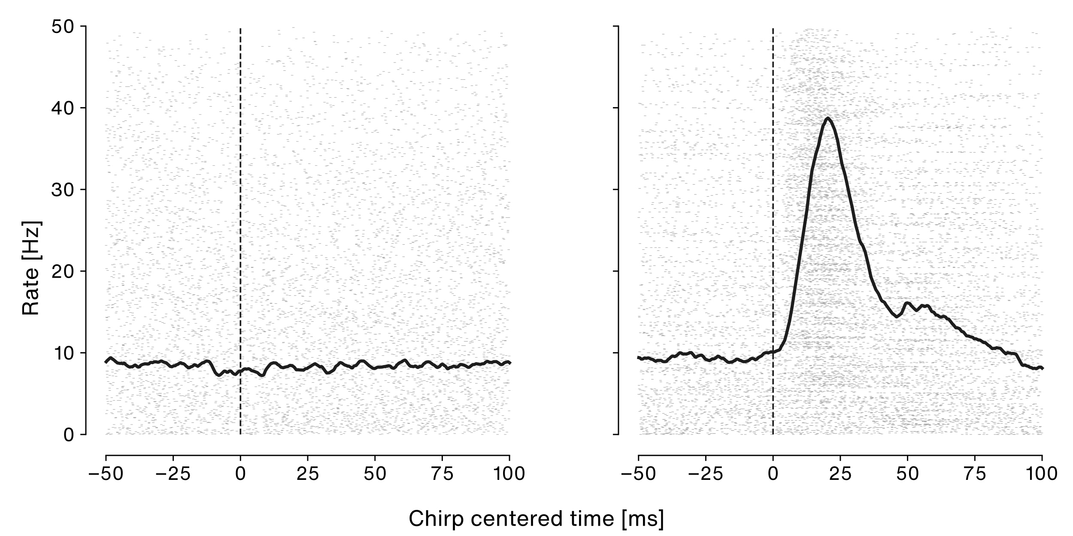
Results – Chirp response
Last year!
Our cell!
Notes:
Y: Firing rate estimated by kernel density estimation (causal gamma kernel)
X: Chirp centered time, i.e. chirp at 0 where line is
Background: Rasterplot of spikes across all trials
For all stimulus phases
For all difference frequencies
So this is ALL data pooled
Left plot: Cell not reacting to a chirp stimulus
Right plot: Cell that increases firing rate after chirp
Guess which cell we recorded from?
Left cell: First pyramidal cell with stable recordings after 4 full recording days
Right: ELL cell from same project from last year
Based on this we can either assume that our cell does not react
Or we could take a closer look:
Pooled the data based on beat frequency and relative difference frequency between stim and fish

Slide 19
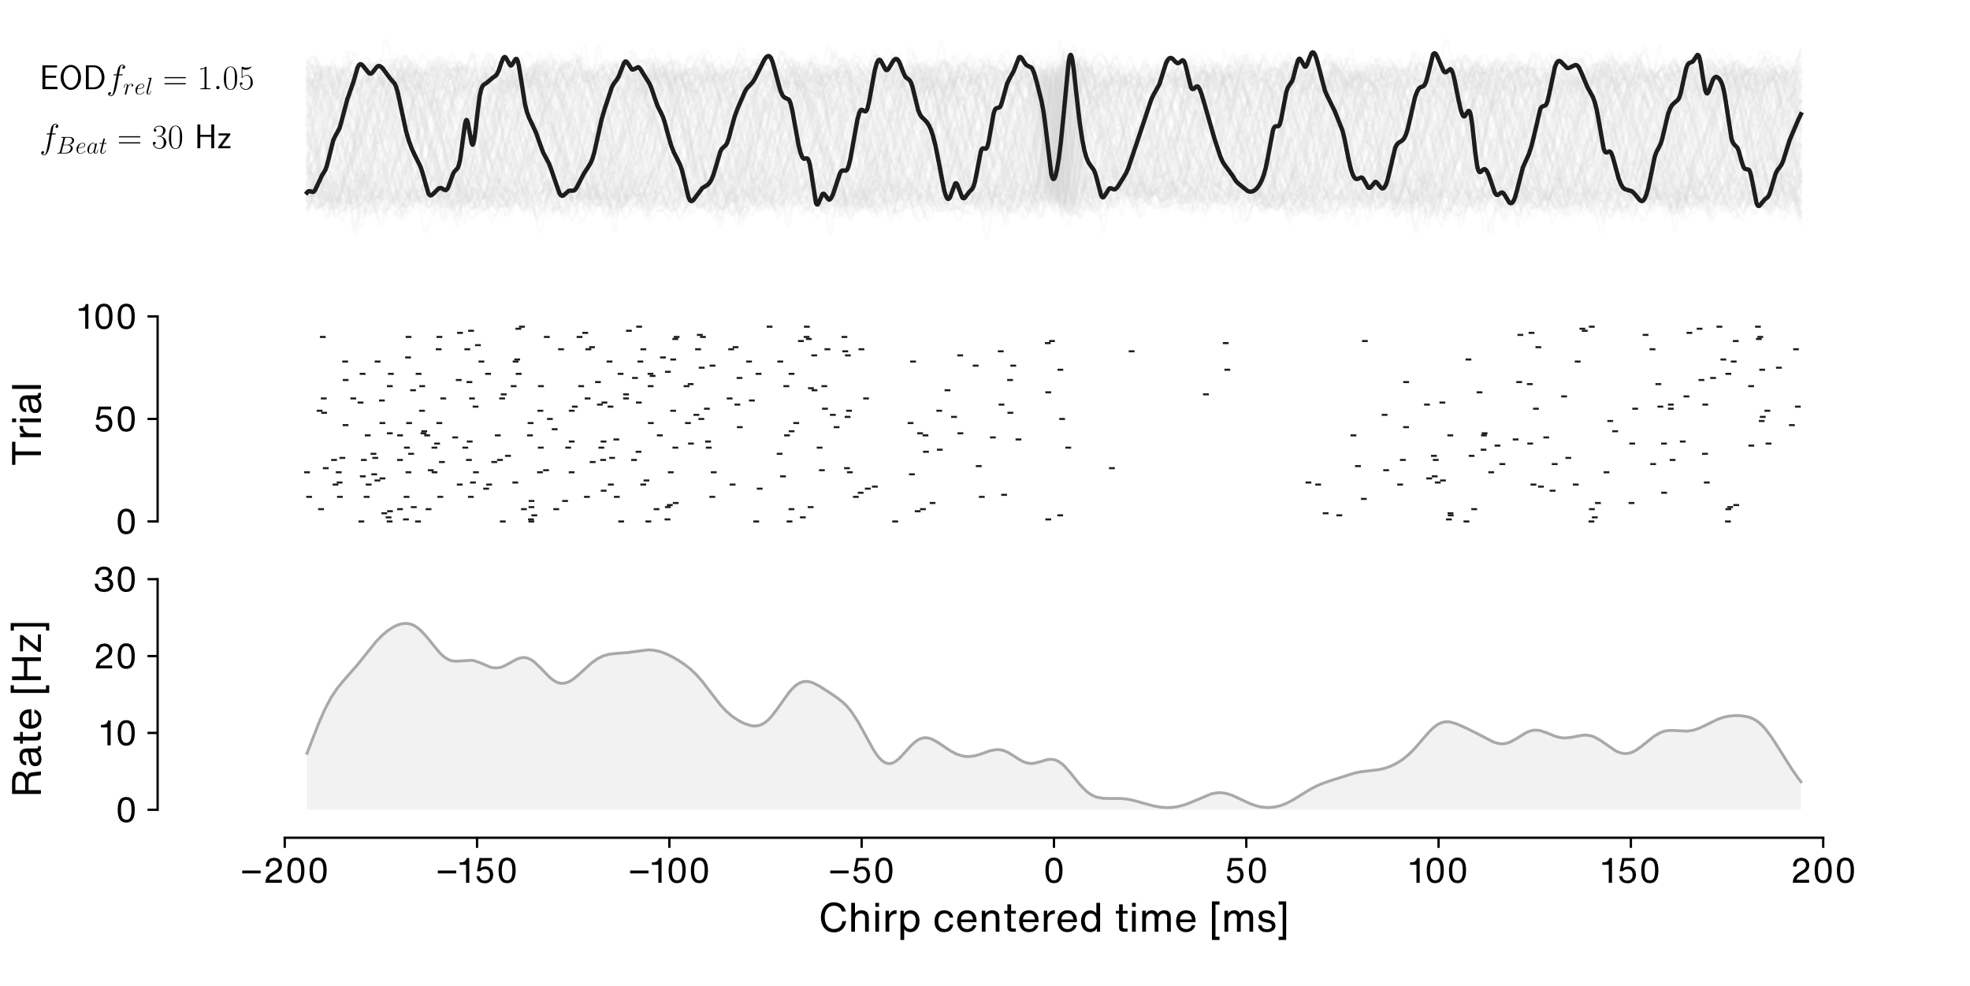
Results – Chirp response
Notes:
For a single stim, we find this
Top: Beat envelope, i.e. the stimulus used
Different phases but same beat frequency and difference frequency
In the center we see a chirp
Black line is one trial
Middle:
Y: Trial number, played 96 chirps to the cell, for each trial the rasterplot
Below:
Y: Firing rate estimated by a gamma kernel
X: Time relative to chirp
Rasterplot and firing rate show drop in activity after chirp
Indicates an OFF response to chirps
But: This is only observable for a single stimulus

Slide 20
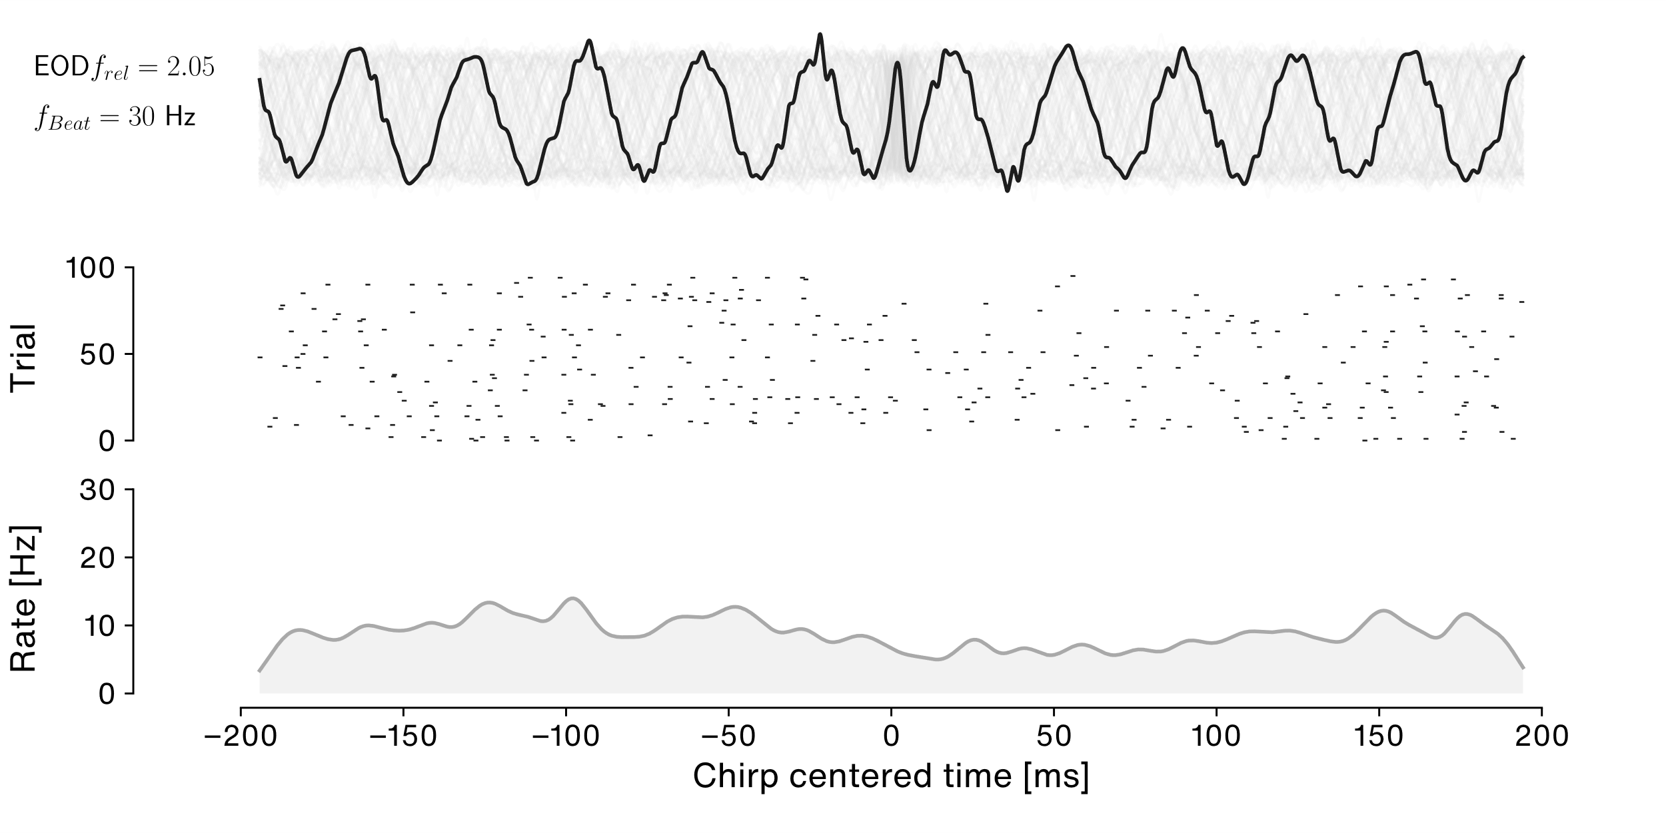
Results – Chirp response
Notes:
The same plot, the same beat frequency but two-fold relative frequency.
Before, simulated fish was 1.05 times the EODf, now 2.05 times.
Stimulus is the same because beat envelope is the same for the same beat frequency
But actual frequency of chirp playback was greater
Rasterplot and time dependent firing rate show now obvious change in response to chirp
This is true for most other stimuli
Conclusion: In one case, our cell may react to a chirp. But overall not really.
Opens question: Does the cell react to the stimulus at all?
Chirp is played back on top of a beat, simulating another fish.
Some ELL cells fire in phase with the beat envelope.
How does our cell react to the beat itself?

Slide 21
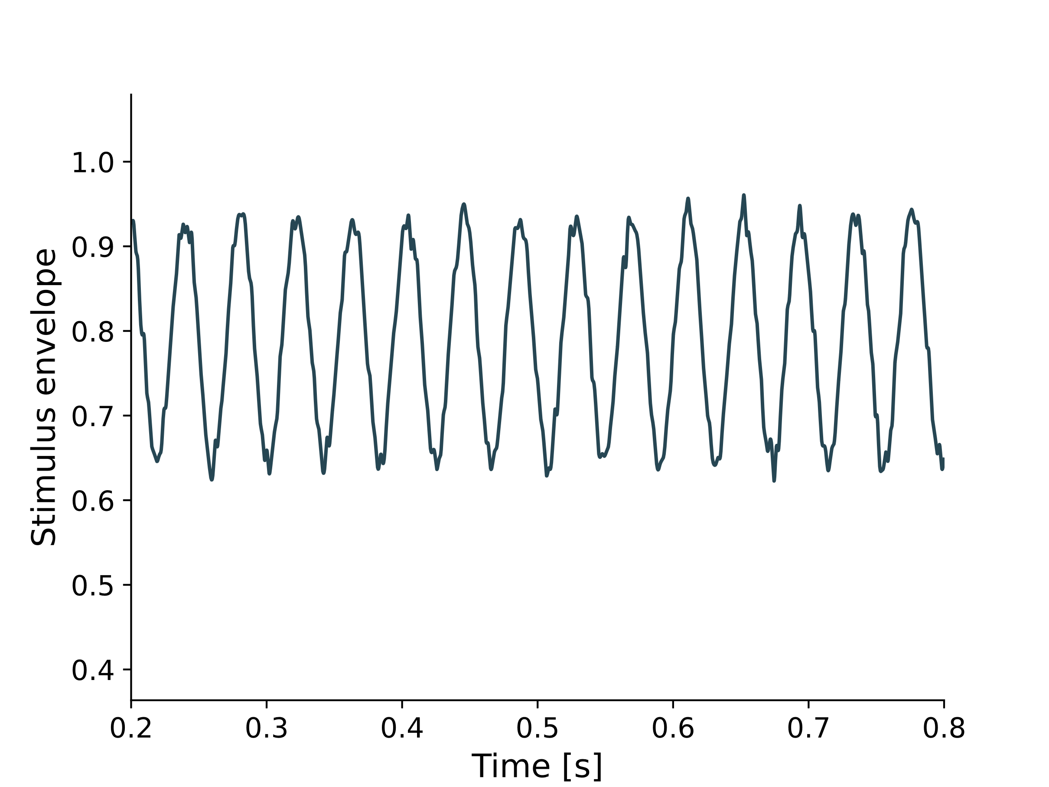
Results – Beat response stimulus
Notes:
Y = Stimulus envelope of SAMs
X = Time in s (zoomed into first trial)
Higher than the fish EOD
SAM: Sinusoidal amplitude modulations
Produce a beat
Without chirp or other stimuli
Can be used as stimulus used to investigate the beat response

Slide 22
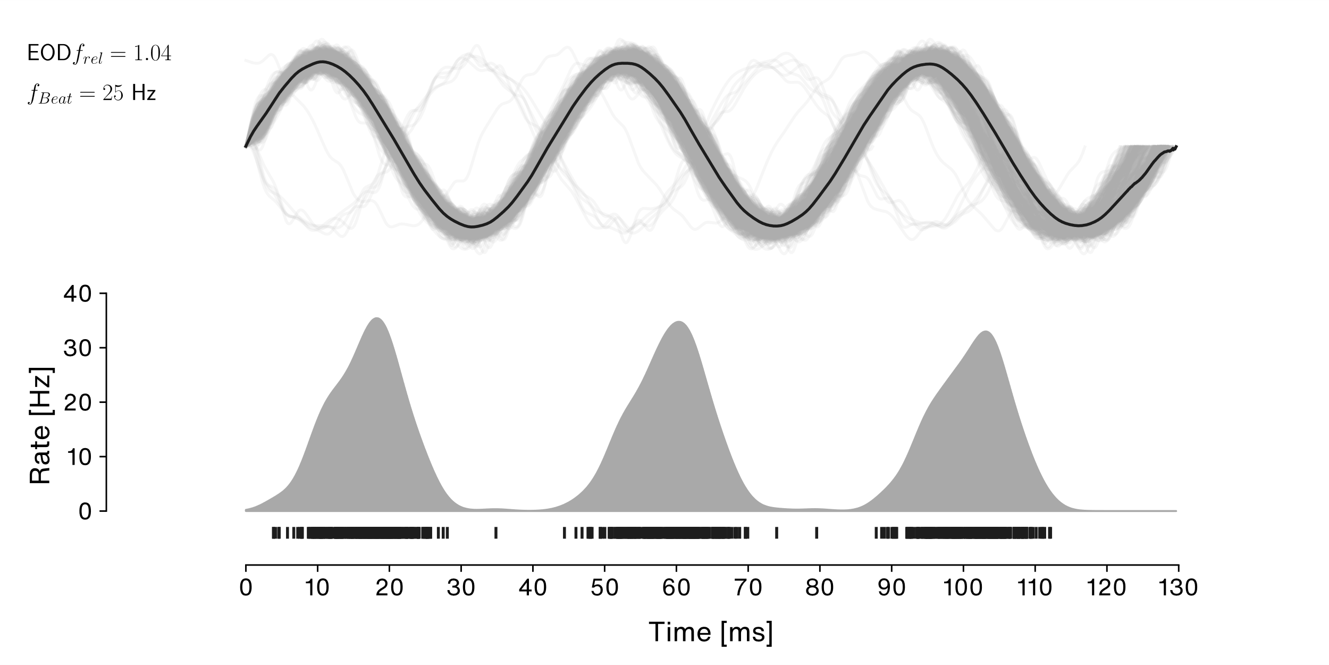
Results – Beat response
Notes:
Top: Envelope of beat as result of stimulation with SAM
Simulates a fish with 1.04 x fish EODf
Results in beat of 25 Hz
Bottom:
Y: Firing rate estimated by Gauß kernel in Hz
X: Time centered to onset of first beat
Response of our cell to 3 consecutive beat periods
Below firing rate:
Rasterplot with spikes pooled over all trials
We see: Firing is coupled to beat period, peaks at almost 40 Hz while 0 between beat peaks
If we increase beat period, spiketrain is phase shifted and response slightly decreases

Slide 23
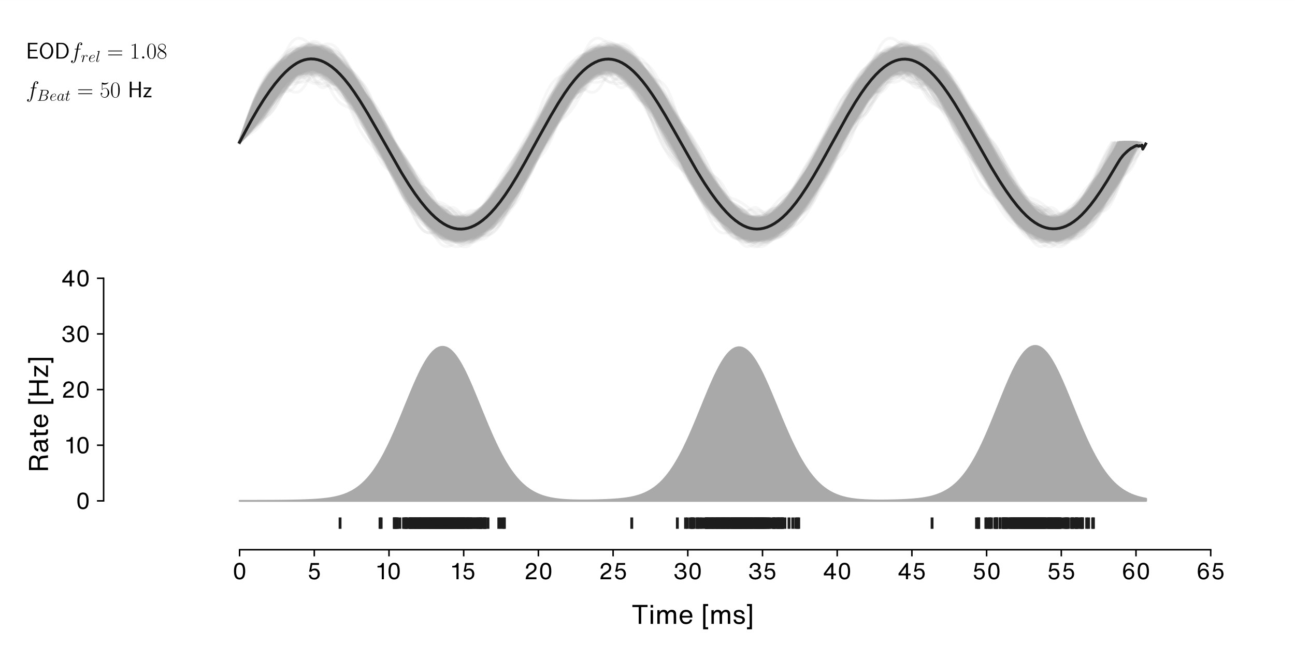
Results – Beat response
Notes:
Same plot but KDE peaks are shifted to the left
We are now at 1.08 EOD multiples, double the beat frequency with 50 Hz
Peaks decrease to ca 30 Hz but response between peaks is still low
Next plot: add another 25 Hz to beat frequency

Slide 24
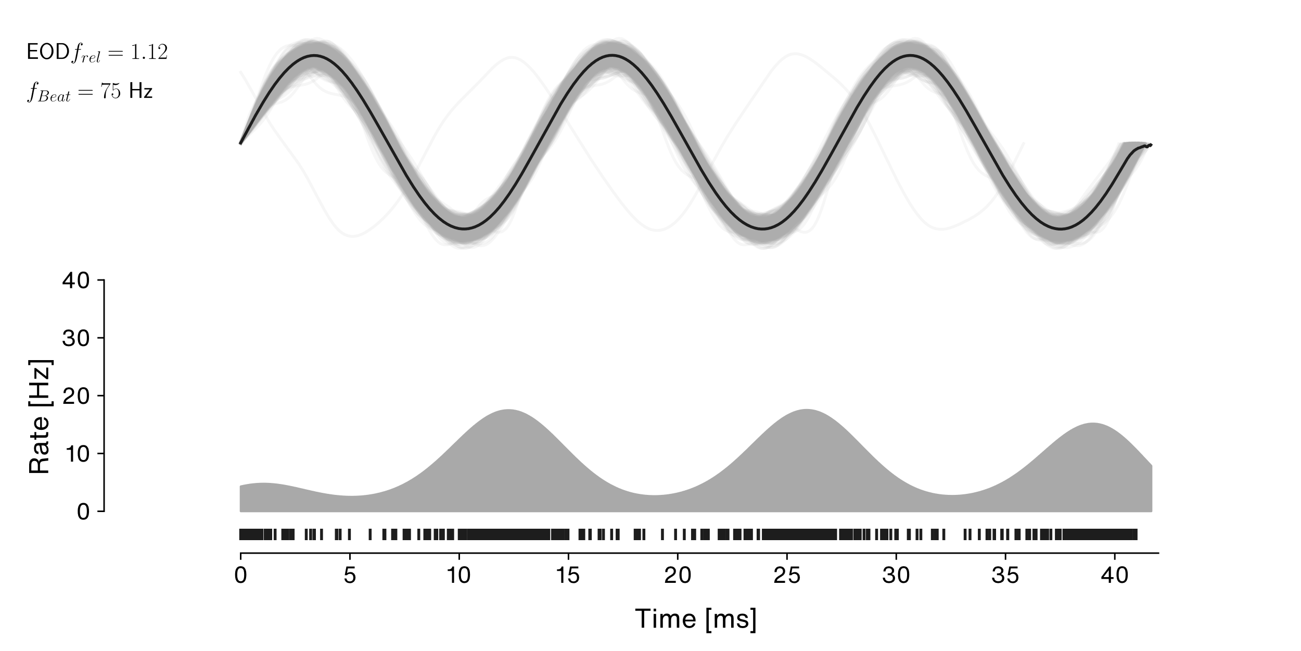
Results – Beat response
Notes:
Beat frequency is now at 75 Hz
Again see a phase shift
Peak rate decreases to little below 20 Hz
See activity between peaks
Conclusion:
Our cell spikes coupled to the beat
It appears to be inhibitory
BUT:
We dont know the input lag, since the P-units inntervating the cell could be in the from or the tail of the fish
And: The fish is a dipole! So the envelope switced sign approx 2/3rds down the body
This is not very conlcusive! Question: What is this cell tuned for?
Jans notes:
- Präzision/Phasenkopplung

Slide 25
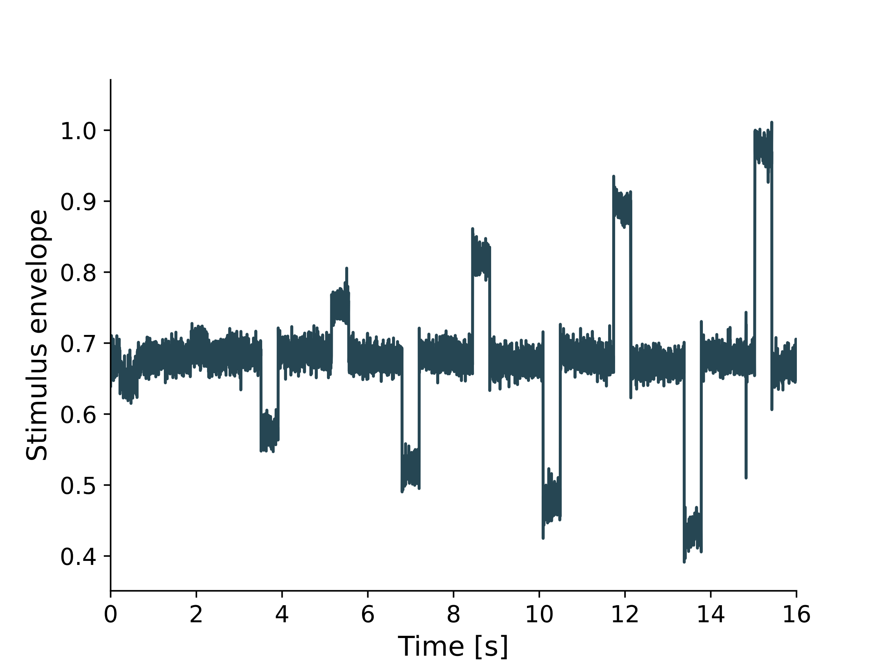
Results – FI Stimulus
Notes:
Stimulus: Steps in beat amplitude with varying contrast
Y = Stimulus envelope of the 10 contrasts of the first trial
X = Time in s (zoomed into first trial)
Contrast = % of amplitude of receiver EOD
So contrast (i.e. relative difference due to stimulus) can be negative and positive
Example: If the receiver EOD has amplitude of 10 and the contrast is 30%, the amplitude step (in either direction) would be 3
If we plot the response to the steps in firing rate against the constrast, we get a contrast tuning curve

Slide 26
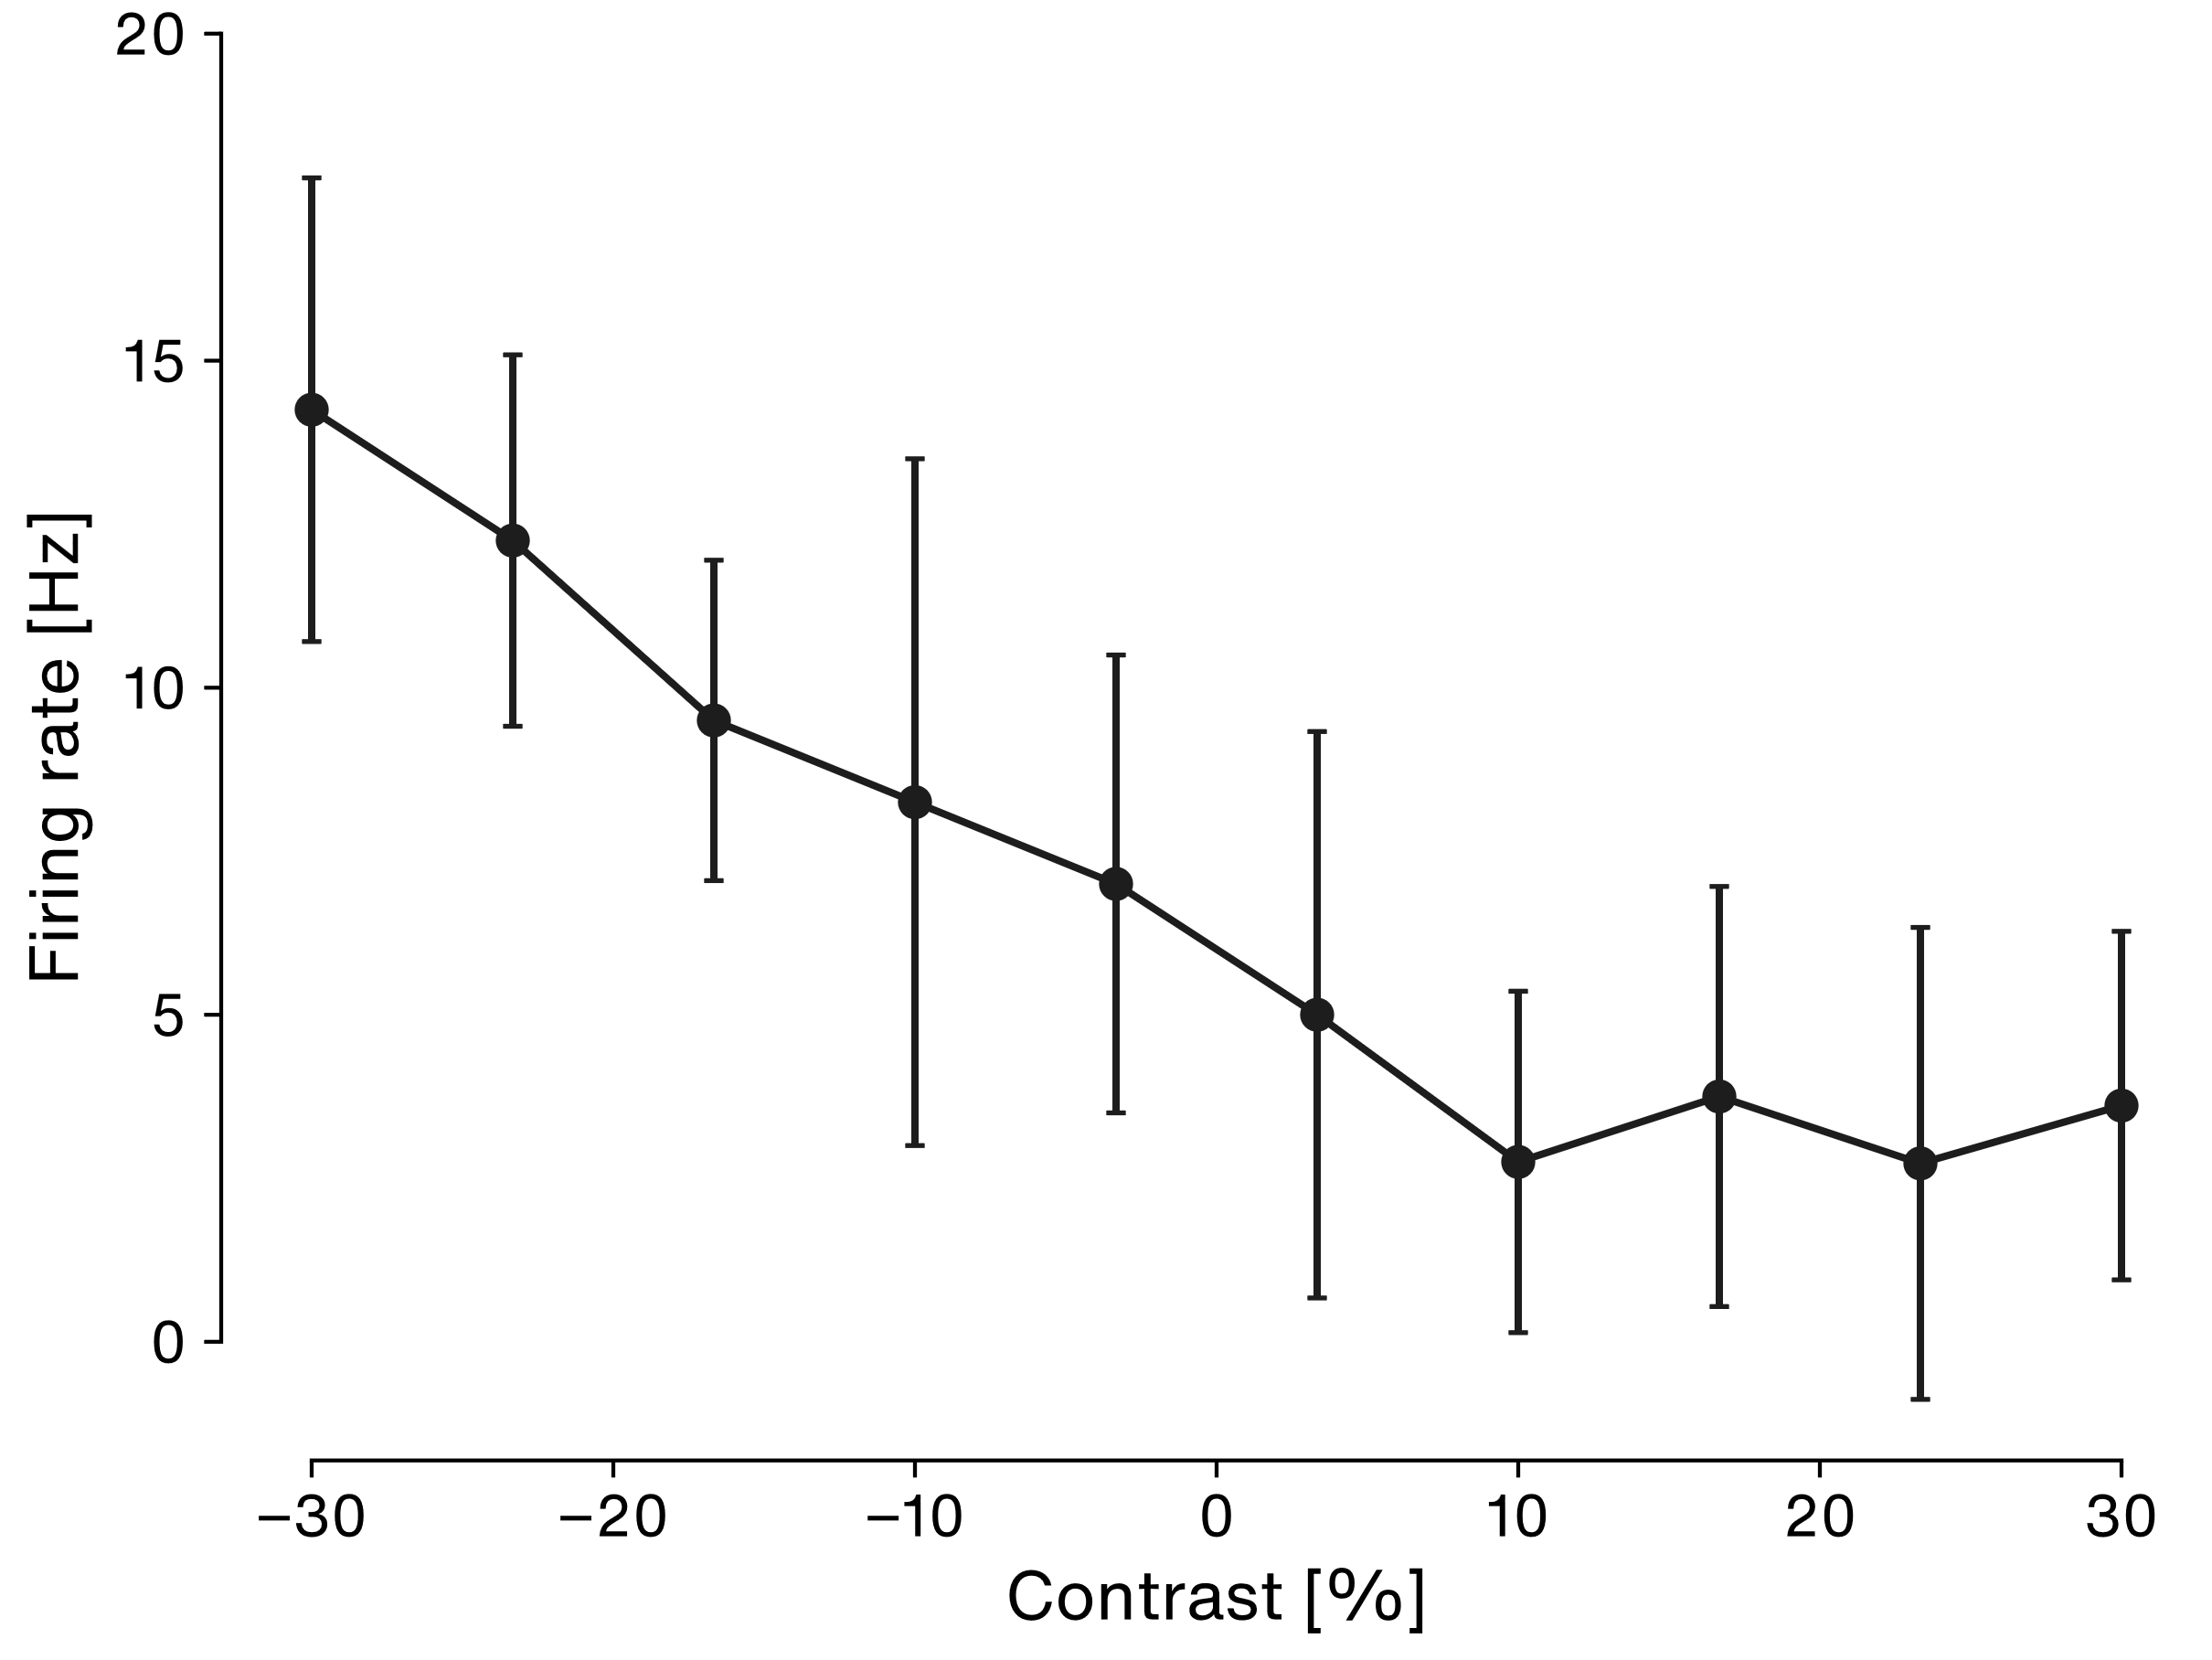
Results – FI curve
Notes:
Tuning curve:
Y = Firing rate [Hz] with std
X = Contrast in %
10 trials per contrast
Firing rate is higher for negative amplitudes -> indication that our cell is an OFF cell
This means it activates at amplitude troughs of the beat stimulus
This gives us an idea of when we should see spikes
We can validate this assumption by computing a spike triggered average stimulus
Jans notes:
- Off zelle die auf kleinere amplituden reagiert

Slide 27
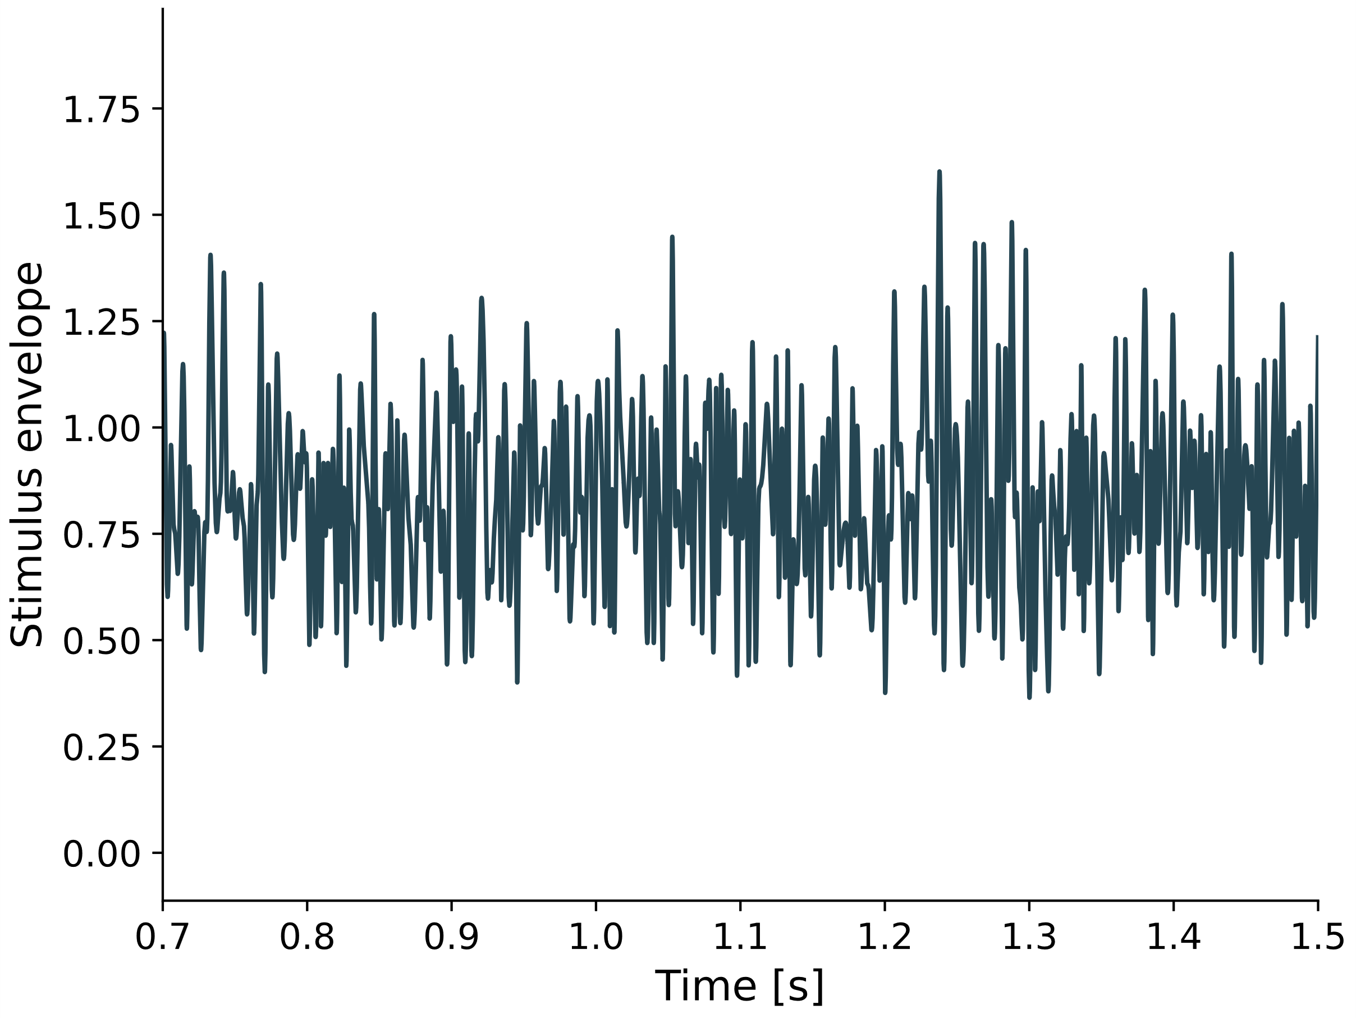
Results – RAM Stimulus
Notes:
Stimulus used for the STA:
Y = Stimulus envelope of RAM stimulus
X = Time in s (zoomed in beginning of first trial)
Trial: 20 * 10s
RAM = Random amplitude modulations.
Instead of steps (remember FI curve) we now change the amplitude in a random manner.
The beginning shows a pause: Beat envelope is stable, because it is the envelope of the fish EOD
Then stimulus turns on: Beat envelope is modulated in a random way
To compute the STA:
At each spike during the RAM, cut out a small time window of the stimulus and average it
We should get the average stimulus at which a spike occurs: Spike triggered average

Slide 28
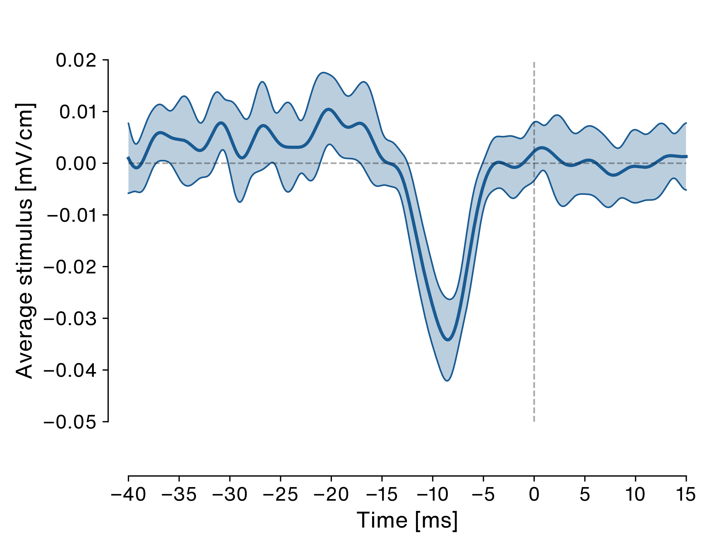
Results – Spike triggered average stimulus
Notes:
Y: Average stimulus in mV/cm
X: Time centered around a spike
Average spike triggered average with standard deviations of the spike triggered average
Small positive peak – indicates weak lowpass filter
Large negative peak – indicates strong highpass filter
Also fits to our contrast tuning curve: Spikes at troughs in the stimulus.
Spikes at the troughs of a signal
Width of STA about 15 ms
Corresponds to s frequency of 1/0.015 = 65 Hz
Fits into the beat frequency ranges to which it is coupled
So: This could be an OFF cell

Slide 29
ELL pyramidal cells
Electrode
Inhib. feedback
CLS
CMS
Superficial pyramidal cell
LS
MS
Deep pyramidal cell
Interneuron
P-Unit
Notes:
ELL cells can be OFF and ON type.
Both types can be superficial or deep
Result: Avg firing rate of superficials is lower compared to deep (ca 20 vs 80-100)
To determine which type of off cell, look at baseline

Slide 30
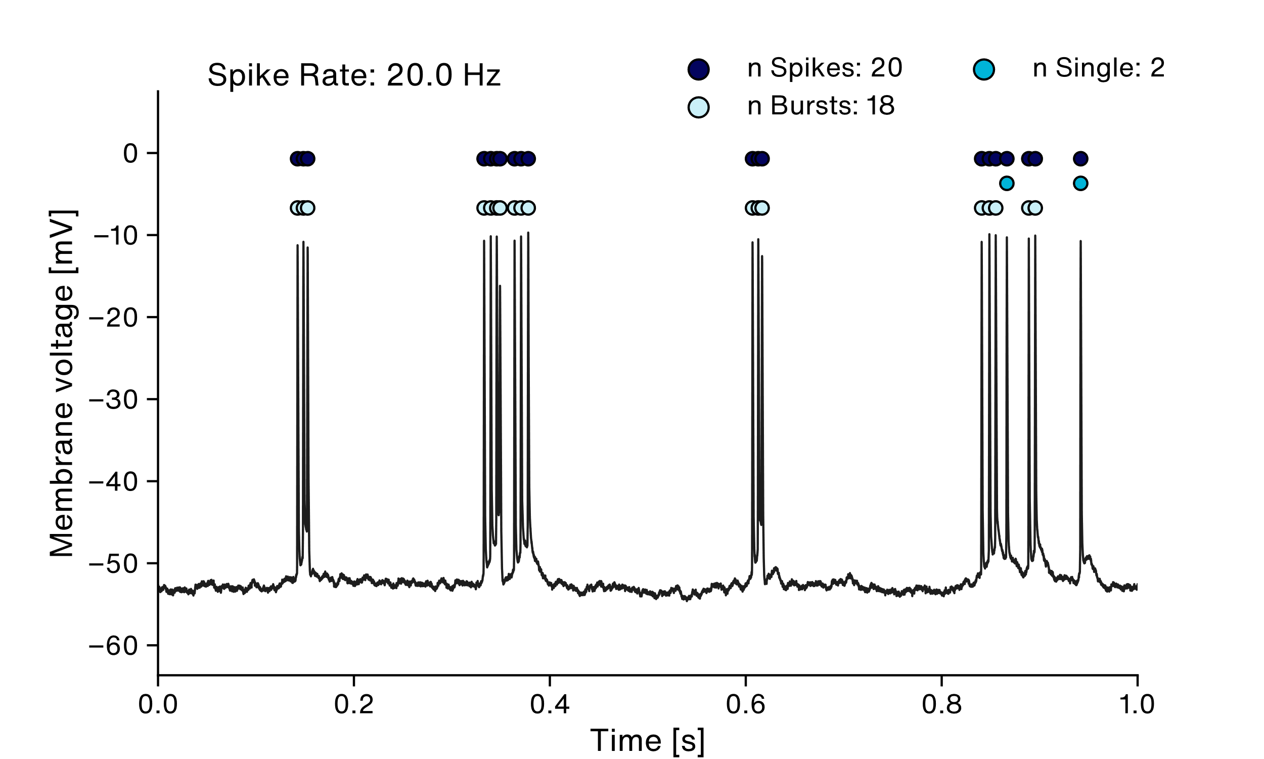
Results – Baseline analysis
Notes:
Window of baseline activity
Y= Membrane Voltage in mV
X = time in Seconds
Spike rate for this window
20 Hz so superficital
We see some isolated spikes at the end
But mainly bursts!
What do the bursts do?
Look at interspike interval histogram to see ISI distribution

Slide 31
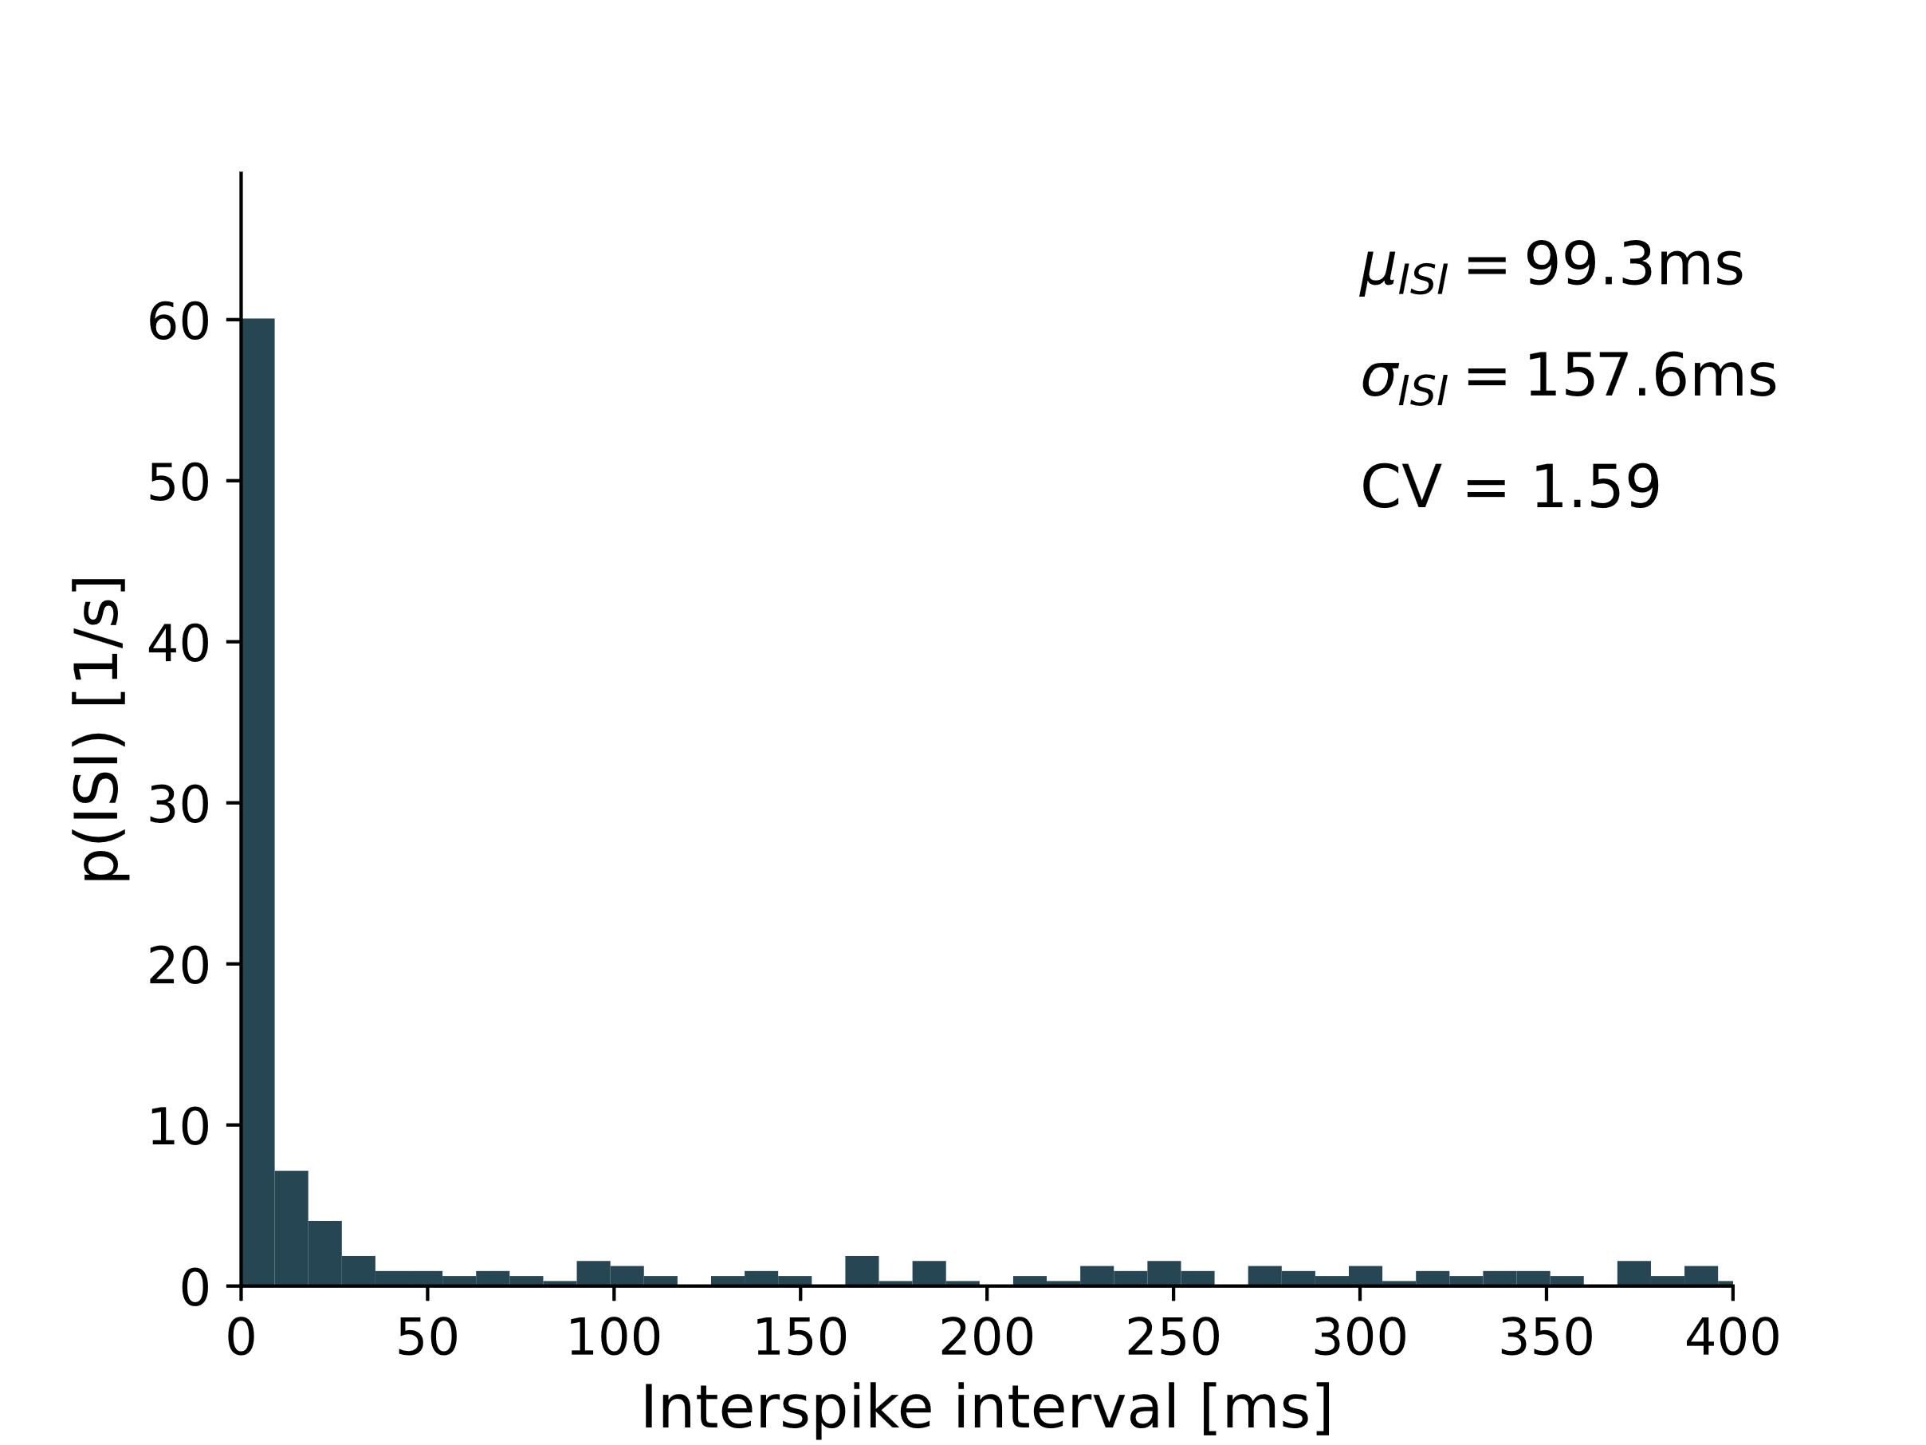
Results – Spikes and bursts
Notes:
Inter spike intervall Histogramm
Y = Probability of ISIs
X = interspike interval in ms
Mean interspike intervals at almost 100ms
CV (coefficient of variation) is normally between 0 and 1,
0 means even
1 means random
If CV is larger than 1, this indicates many very small ISIs separated by large ones
Still: Distribution is not necessarily bimodal

Slide 32
Results – Spikes and bursts
Notes:
There is no clear bimodal distribution
To detect bursts, we chose ISI threshold of 10 ms.
This is used in literature for upstream neurons with much higher rates

Slide 33

Results – Baseline analysis
Notes:
Dots on top represent different events: We detected bursts
Spikes are in a burst if the ISI is lower than 10 ms
Dark: All detected spikes, 128 in this window
Medium blue: All single spikes, i. e. not coupled to bursts (10)
Light blue: All spikes associated with a burst (118)
In the baseline, many spikes occur in bursts
What do the bursts code for?

Slide 34
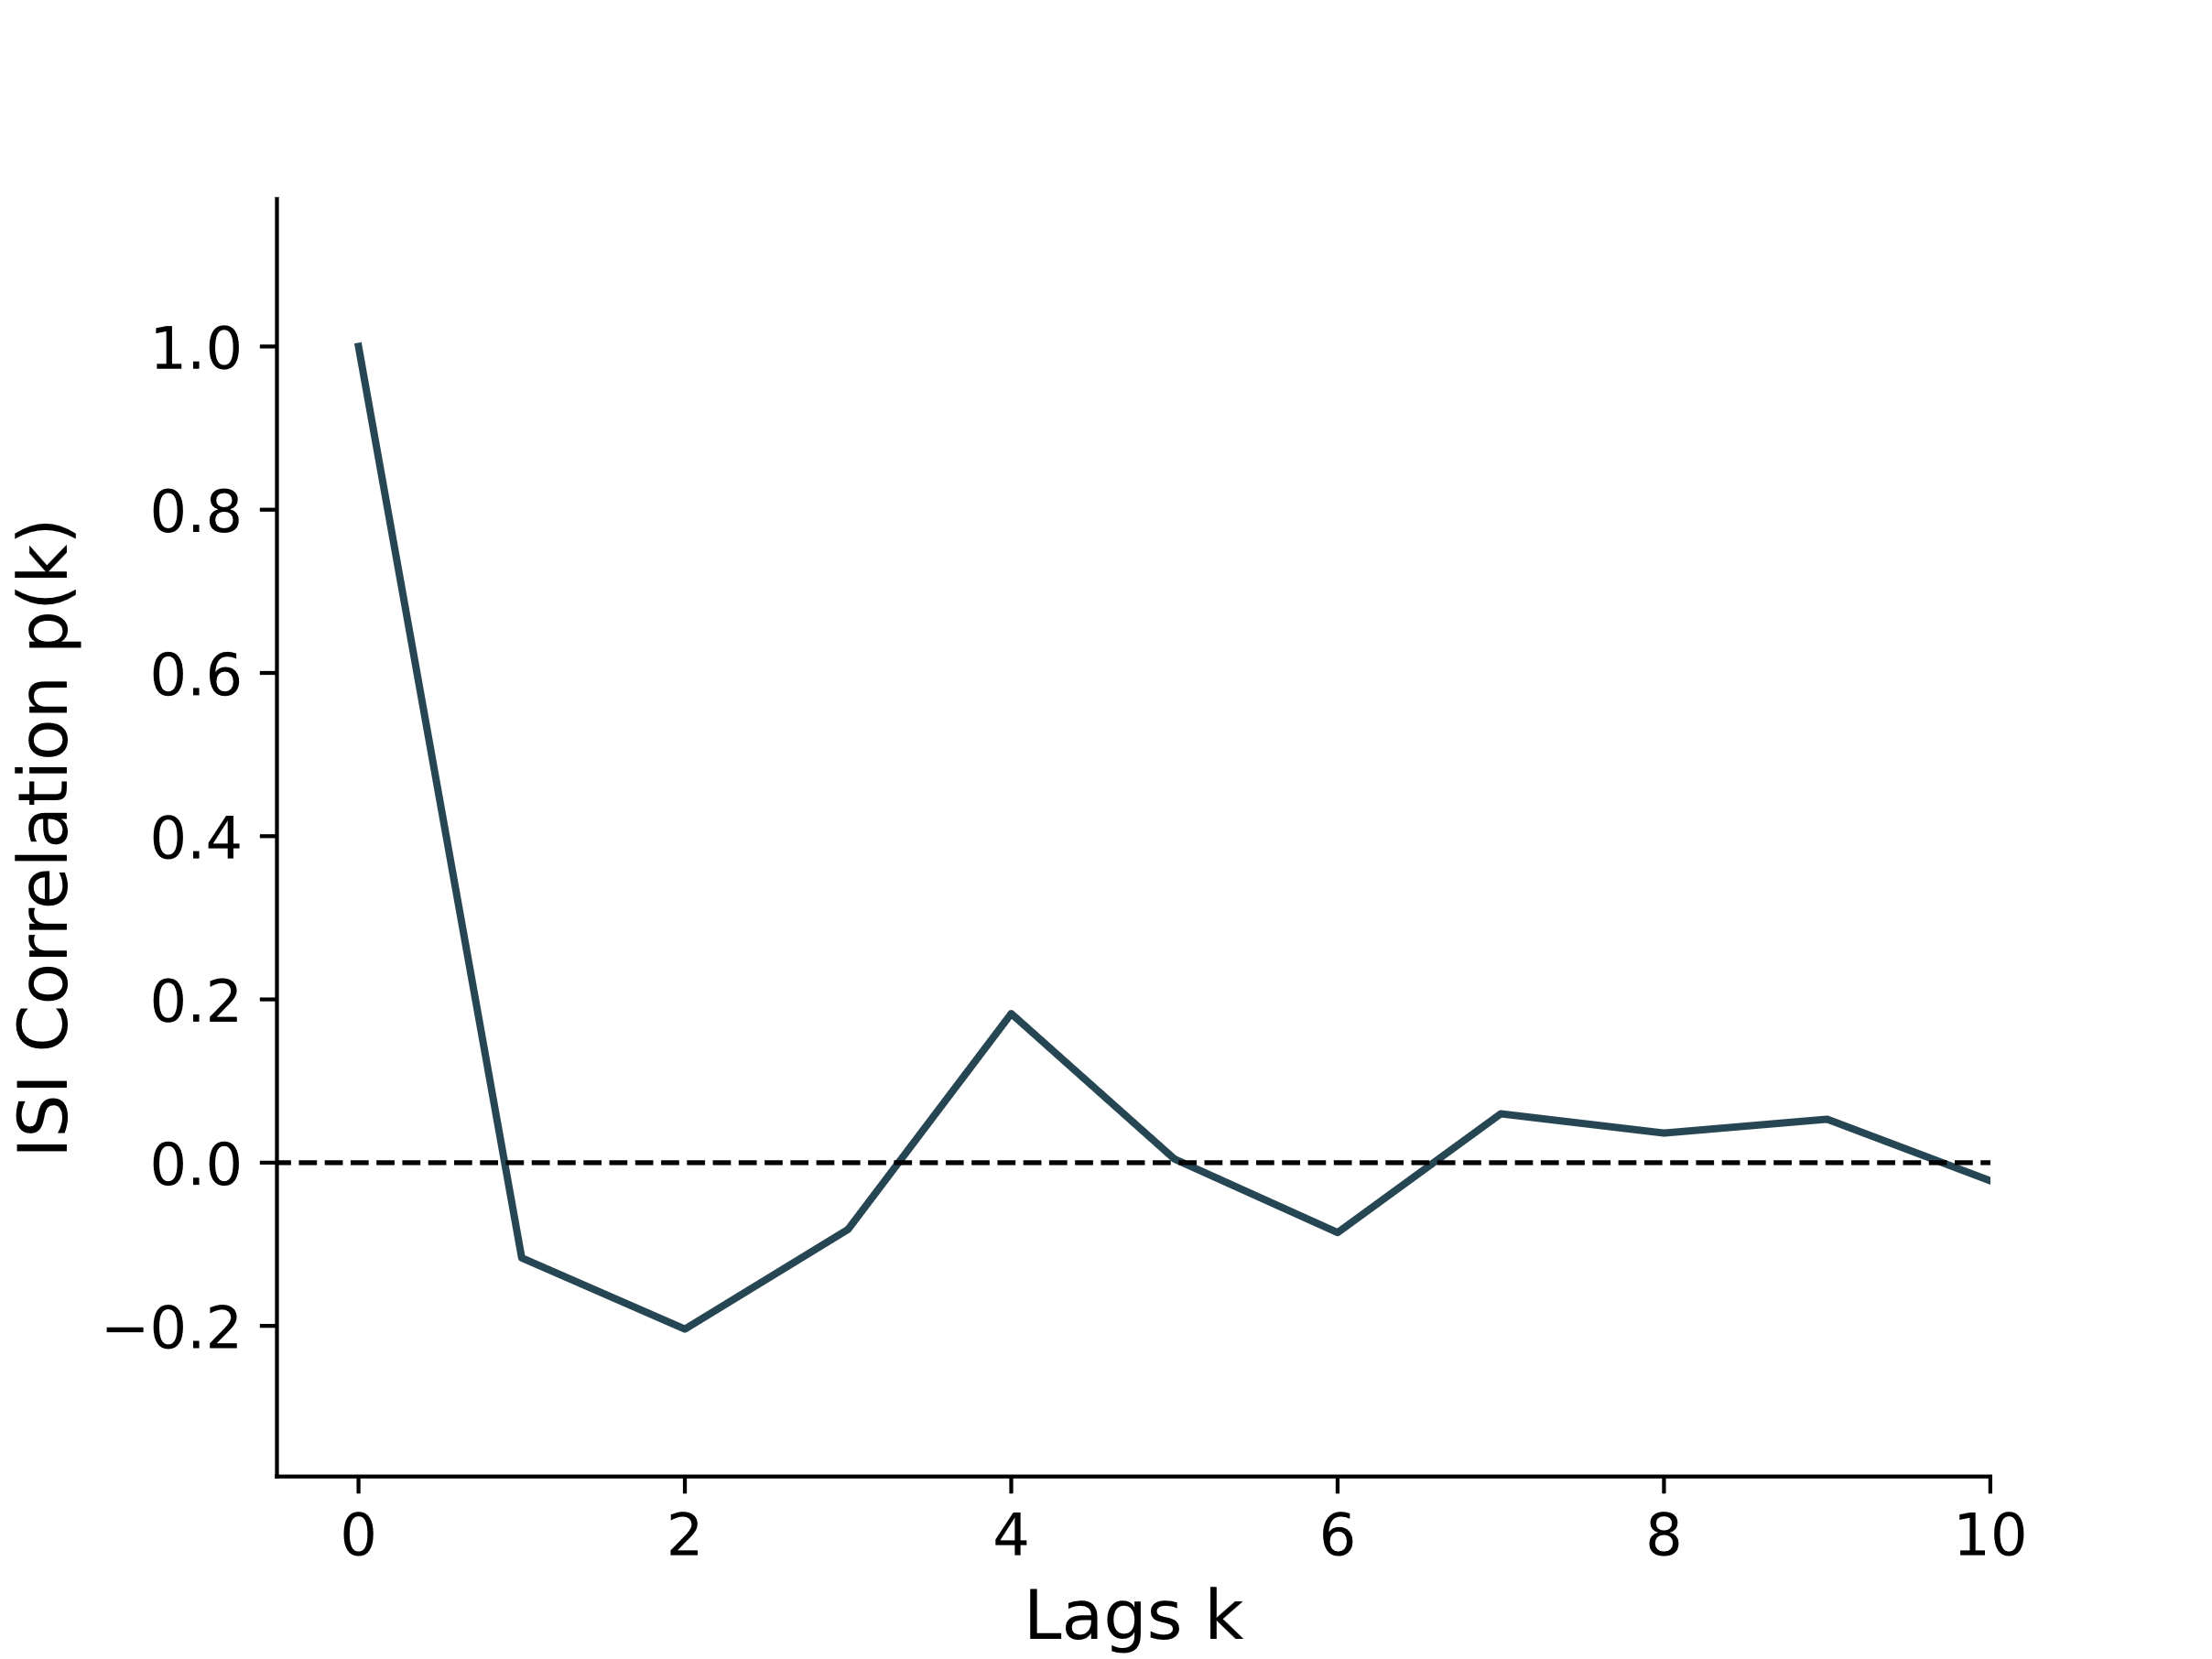
Results – Spikes and bursts
Notes:
Autocorrelation of interspike intervals
Y = ISI correlation p(k)
X = Lags (k)
For ISIs of spike 2 and 3: Negative correlation
Indicates decrease of ISIs after a spike, i.e. bursts
Becomes positive at 4, meaning most bursts are not longer than 4 spikes long
Then levels to 0, meaning independent ISIs
Next question: What encoded in bursts and what is encoded in single spikes?
Jans notes:
Weglassen

Slide 35
Results – Spike triggered average stimulus
Notes:
Earlier we presented the STA, i.e. the average stimulus that triggers a spike
Now we split that:
We would want to know if the burst still codes for something specific compared to single spikes
Compute the average stimulus that triggers a single spike
Compare STA that triggers a burst

Slide 36
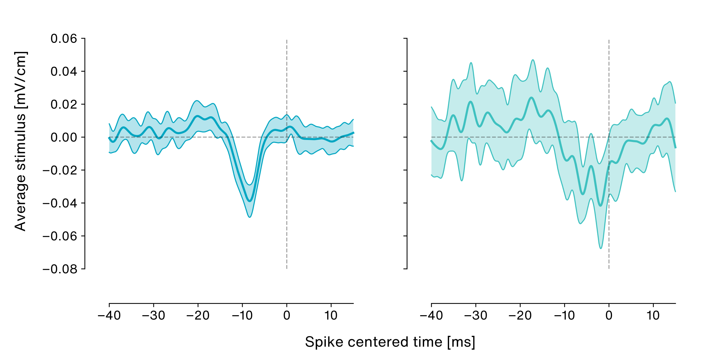
Results – Spike triggered average stimulus
Single spikes
Bursts
Notes:
Again STA:
Y: Average stimulus
X: Time centered to spike
Left side: STA for bursts
Right side: STA for spikes
Issue: Burst rate was much lower during stimulation
A burst of multiple spikes is treating like a slingle event
Much less bursts than single spikes
results in larger error for BTA
In addition: Delay before spike is lower for BTA
How can we quantify the actuall efficiency of the STA?
Which one is better in coding for the stimulus?
We can use the STA as a kernel and convolve the spiketrain with it to reconstruct the stimulus based on the kernel

Slide 37
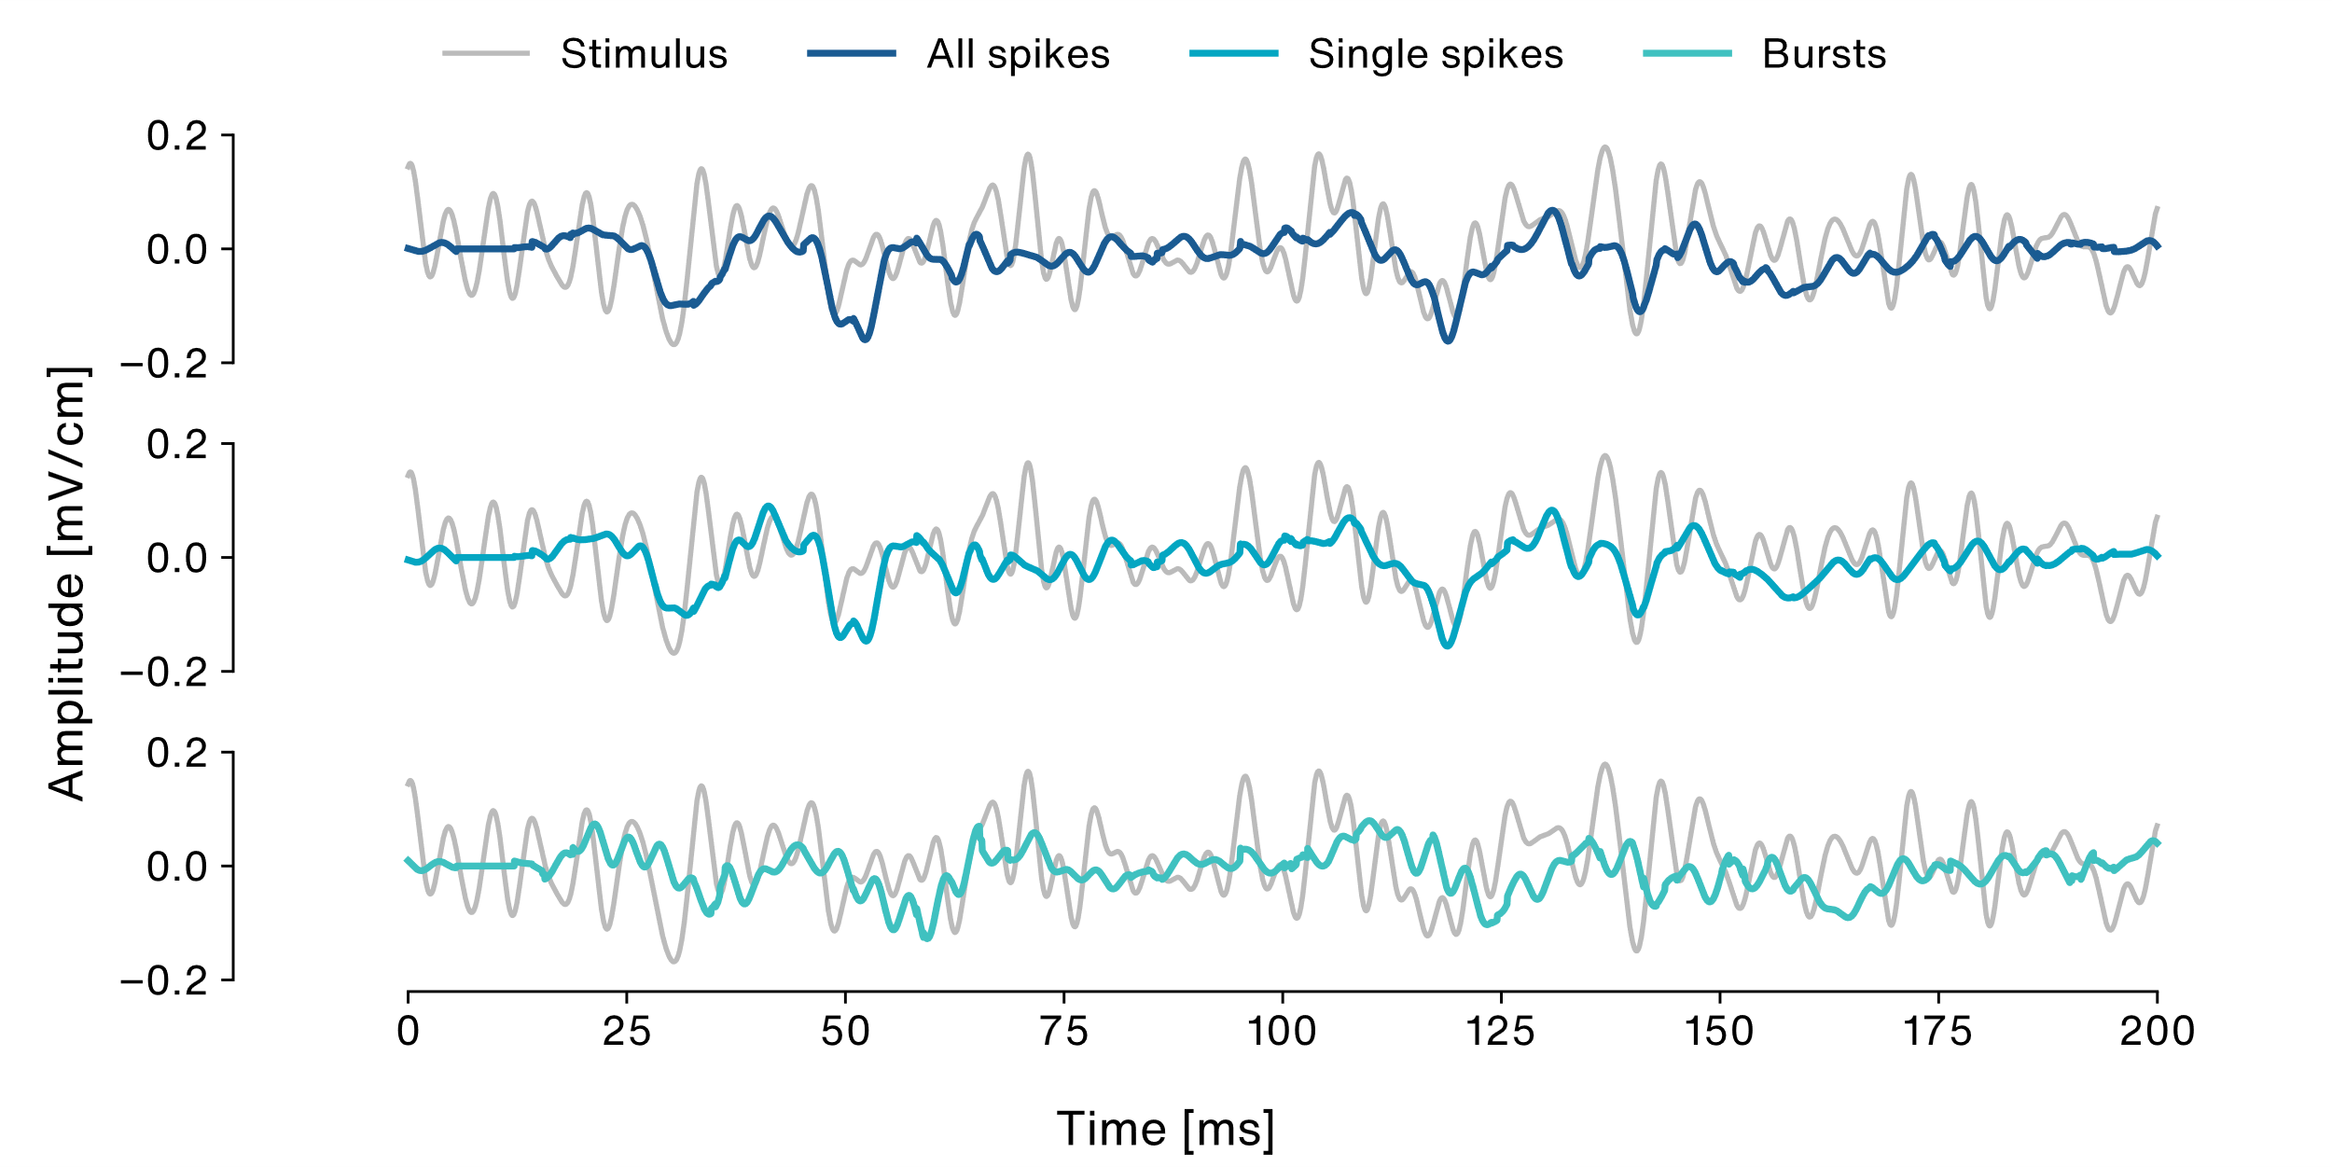
Results – Stimulus reconstruction
Notes:
Reconstructed stimuli for 3 STAs
Y: Stimulus amplitude
X: Time
Grey: Original stimulus
Shades of blue: Reconstructed stimuli for 3 STAs
All spikes
Single spikes
Bursts
STAs reconstruct the troughs of the stimulus – to be expected because it spikes at troughs
Difference between all spikes and single spikes low
Bursts seem to be weaker in reconstructing the stimulus
How can we quantify this?
Compute a distance metric between the original stimulus and the reconstruction
The better the reconstruction, the lower the distance

Slide 38
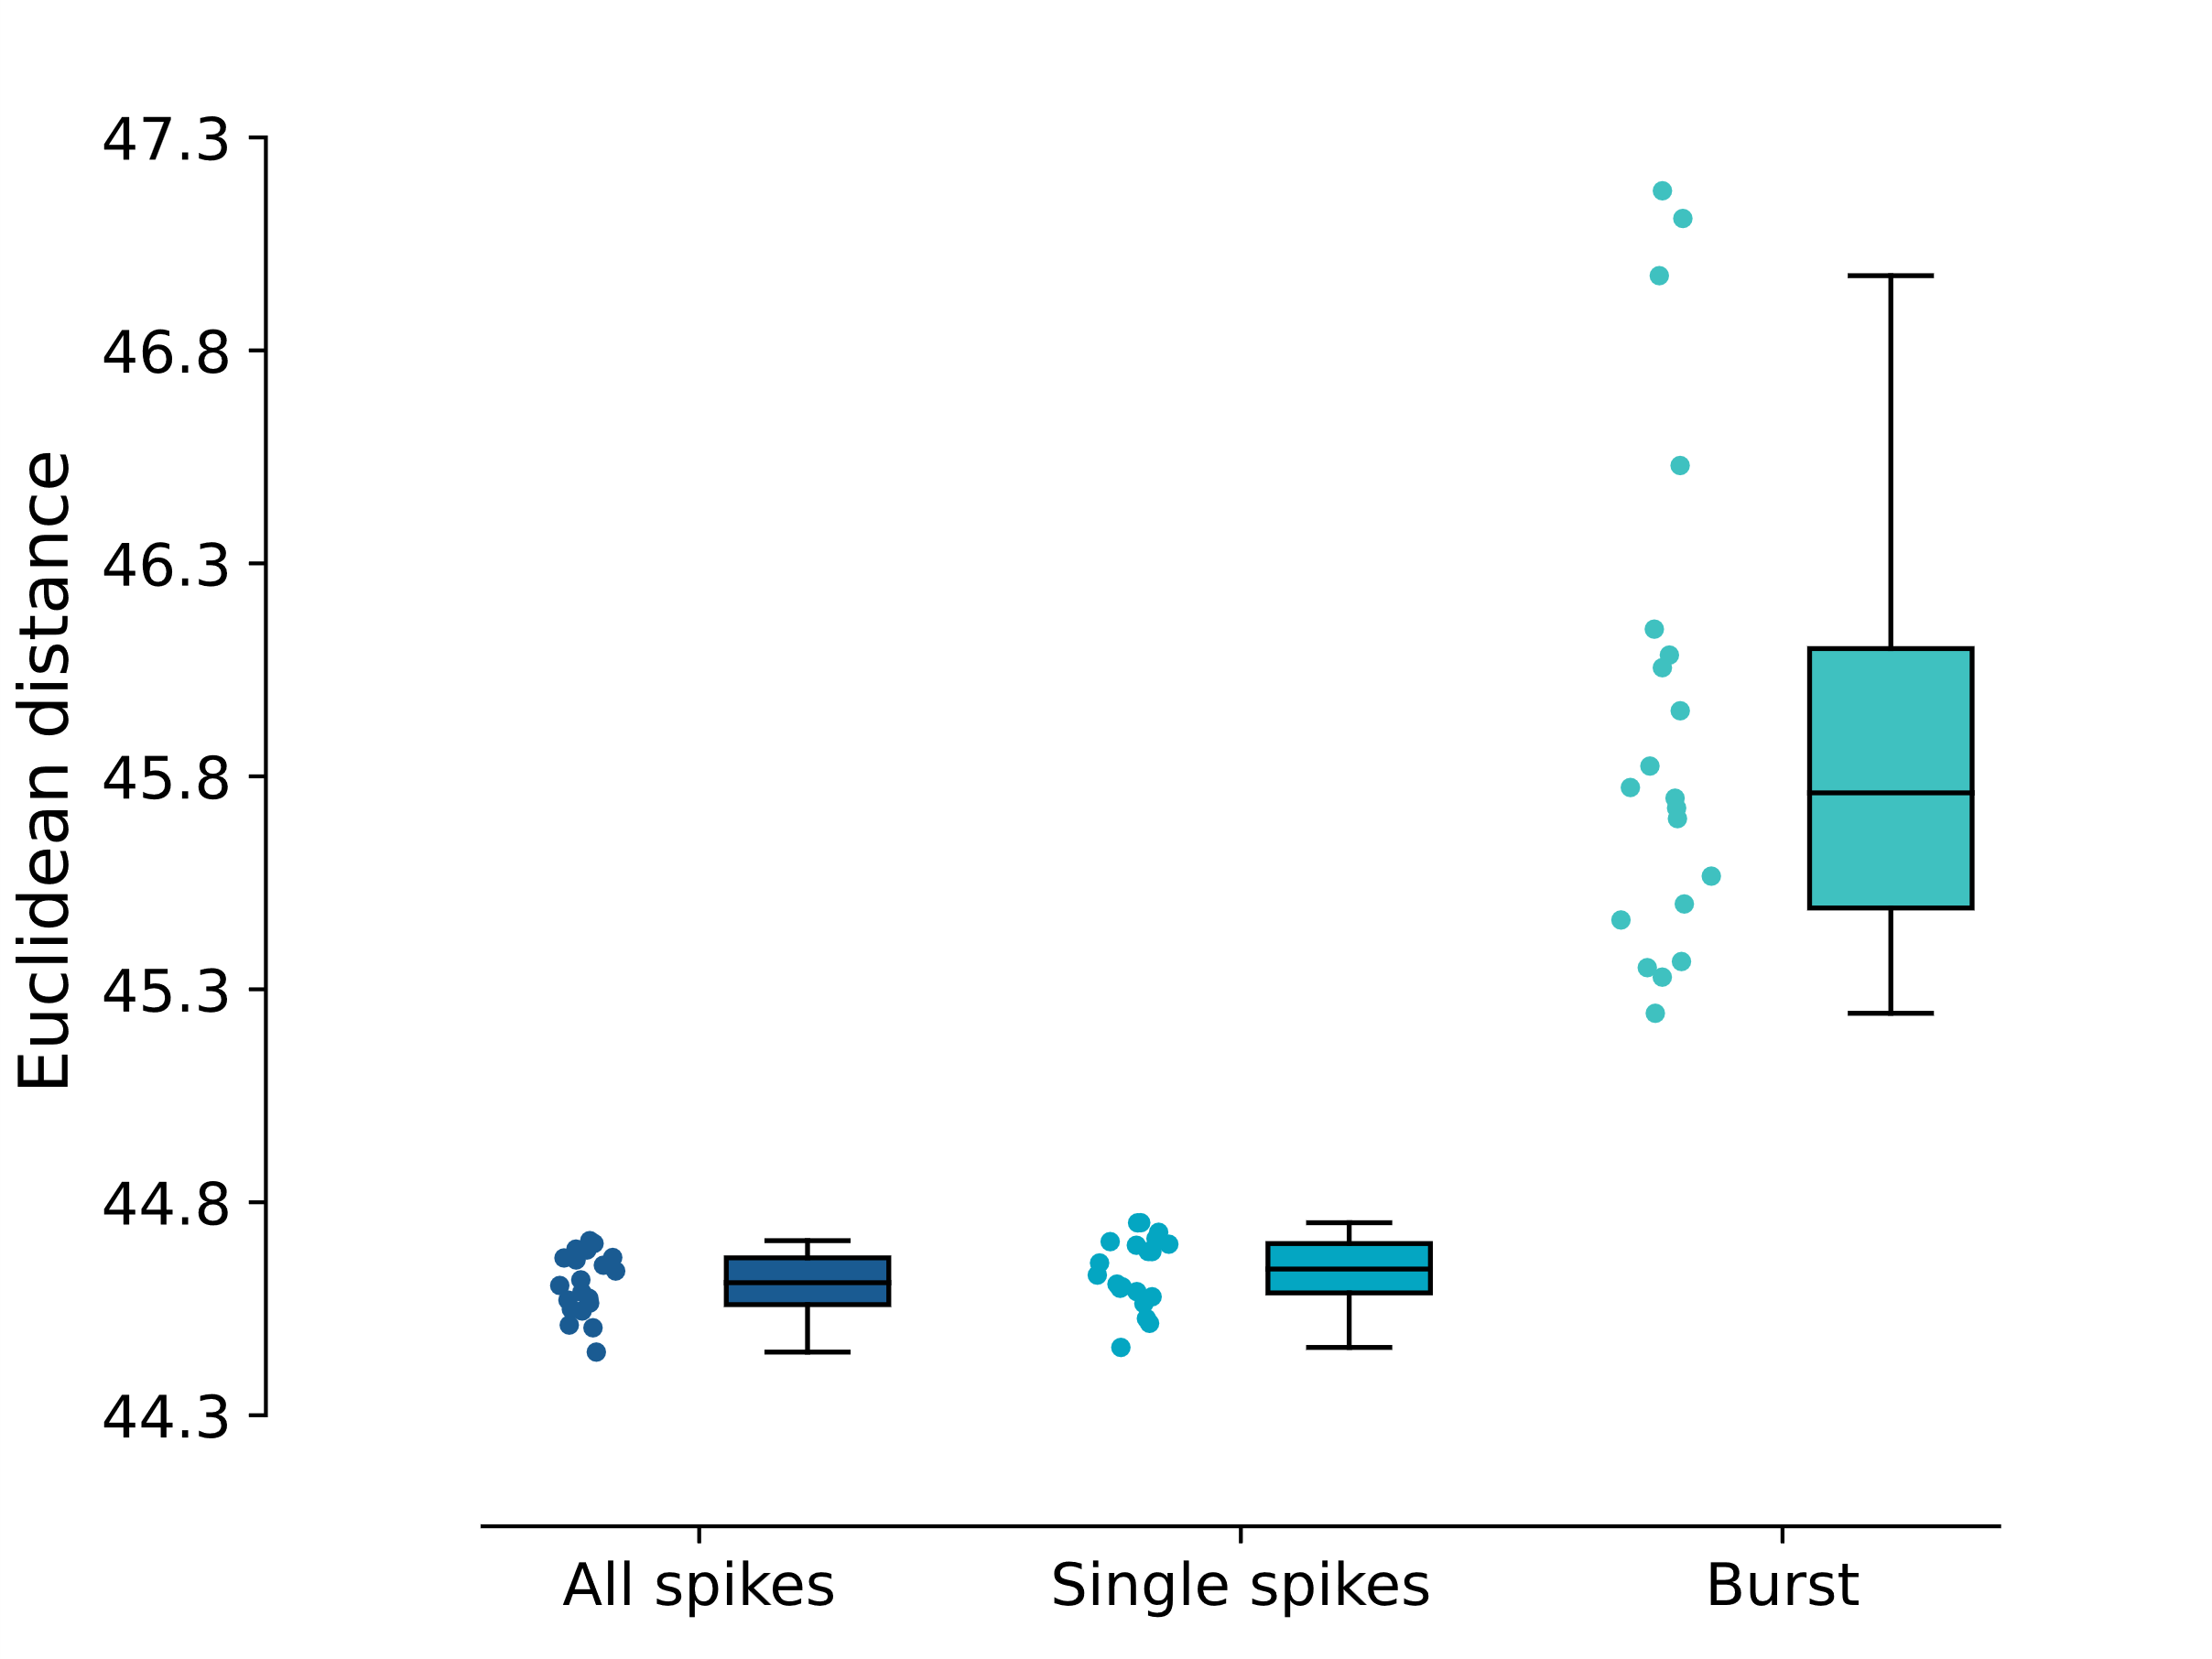
Results – Stimulus reconstruction
Notes:
Plotted distance for all 3 cases
Distance was lower, meaning reconstruction performance higher, for all spikes and single spikes
In comparison, bursts performed weakly
Explanation: Much less bursts than spikes

Slide 39
Results – Stimulus reconstruction
209
2172
1586
Notes:
Only had 209 bursts compared to over 1500 spikes in two other categories
We can conclude that even single spikes code well for our stimulus

Slide 40
Does the cell answer to chirps? Not really …
How are chirps encoded for diverse beats
?
Notes:
Thanks for attention
questions

Slide 41







Phase-locked to beats
Could be inhibitory to one chirps
Tuned for negative contrasts
Spikes to troughs in a signal
Superficial or deep?
Low firing rate
Shallow (-500 $μm$)
OFF - cell
Superficial OFF - cell
Notes:
In summary: The cell was:
Phase locked to beat
May be inhibitory to one chirp
Tuned for negative contrasts
Spikes to troughs in the signal
Indicates off cell
Deep or superficial?
Low firing rate and shallow
Probably a superficial OFF cell

Slide 42
Troughs in the stimulus can be
reconstructed with the STA
Bursts alone may be less efficient
in encoding the stimulus
Notes:
We also showed that the STA was able to reconstruct the troughs in the signal
Showed that despite high baseline bursting, bursts alone are less efficient in encoding the stimulus

Slide 45
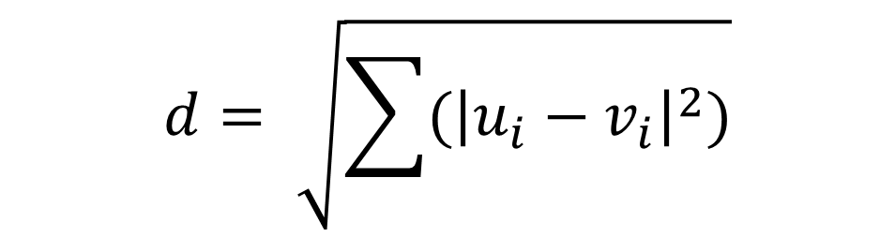
$$d= \sqrt{\sum{{(\left|u_{i}−v_{i}\right|}^{2})}}$$

